Slide 1
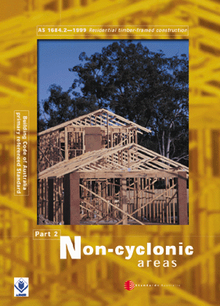
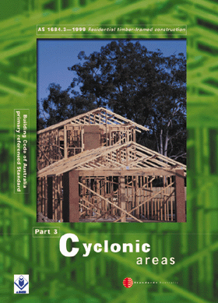
SECTION 7 -
ROOF FRAMING

Slide 2
ROOF FRAMING
7.1 GENERAL

Slide 3
7.1.1 Scope
The Section sets out specific requirements for building practice, design and specification of roof framing members. Reference shall also be made to the footnotes for each member given in the Span Tables of the Supplements.

Slide 4
7.1.2 Types of roofs and limitations
7.1.2.1 General
Raftered roofs (‘pitched’ roofs) shall be either coupled or non-coupled (cathedral or skillion) (see Clause 2.7.4).

Slide 5
7.1.2.1 General
Where splices in rafters or ceiling joists are necessary, they shall be made only at points of support. Splices shall be butt-joined with fishplates of minimum length six times the joist depth. Fishplates shall be a minimum of 19 mm thick by the full depth of ceiling joists. Alternatively, the rafters or ceiling joists may be lapped over the support for a distance equivalent to at least three times their depth.
A4

Slide 6
7.1.2.1 General
Lapped rafters or ceiling joists, or both ends of the butted rafters or ceiling joists to fishplates shall be secured with at least six hand-driven nails, or 8/3.05 mm diameter machine-driven nails, or with an M12 bolt (see Section 9).
Engineered nailplated joists shall be spliced and supported in accordance with the manufacturer’s recommendations.
A4

Slide 7
7.1.2.2 Coupled roof
The roof pitch in a coupled roof construction shall not be less than 10° and ceiling joists and collar ties shall be fixed to opposing pairs of rafters, in accordance with Section 9.
A1

Slide 8
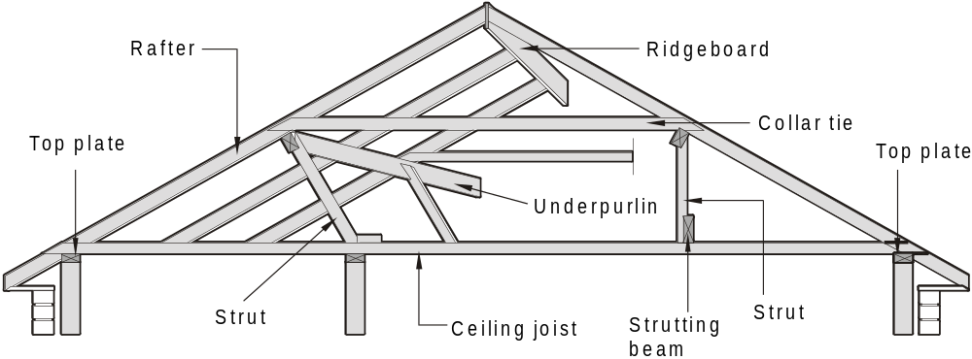
FIGURE 7.1 COUPLED ROOF

Slide 9
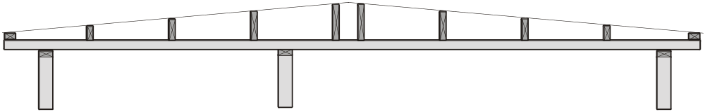
A pitch of less than 10^{O} will not have the triangulation required to be self supporting. Roofs with pitches less than 10^{O} are generally constructed using ‘graded’ purlins.
A graded purlin roof may be constructed various ways and the diagram below is only one example.

Slide 10
7.1.2.2 Coupled roof
Rafters shall be continuous in length from ridge to wall plate, or shall be lapped or spliced at their support points (see Clause 7.1.2.1). Rafters may be supported on underpurlins.
A1

Slide 11
7.1.2.2 Coupled roof
For a coupled roof with no roof struts, provided with nominal fixing only (see Section 9), the maximum distance between external walls shall not exceed 6000 mm for sheet roofs or 4000 mm for tile roofs, except where the roof connections and members are designed in accordance with AS 1720.1.

Slide 12
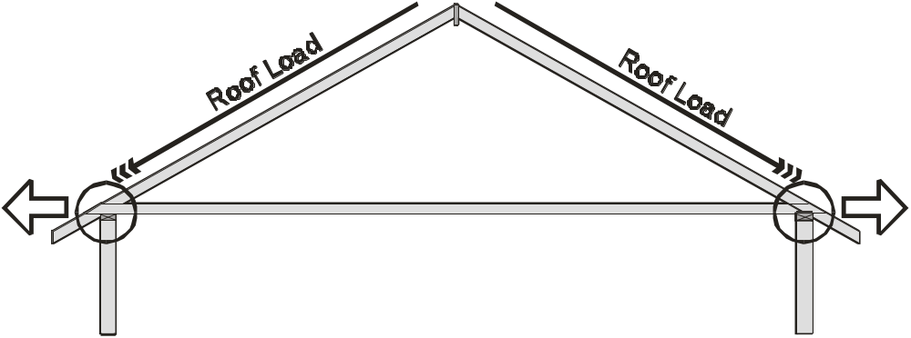
A coupled roof with no roof struts applies the total roof load to the rafter/ceiling joist joints. Nominal fixings at these joints are only strong enough for the limits given above.
Nominal fixings
Nominal fixings

Slide 13
7.1.2.3 Non-coupled roof
A non-coupled roof (including cathedral and skillion) shall have rafters (raking beams) supported off walls, ridge beams and/or intermediate beams.
It may have ceilings in the same plane as the roof.
Rafters, ridge and intermediate beams may be exposed internally (see Figure 2.5).
A1

Slide 14
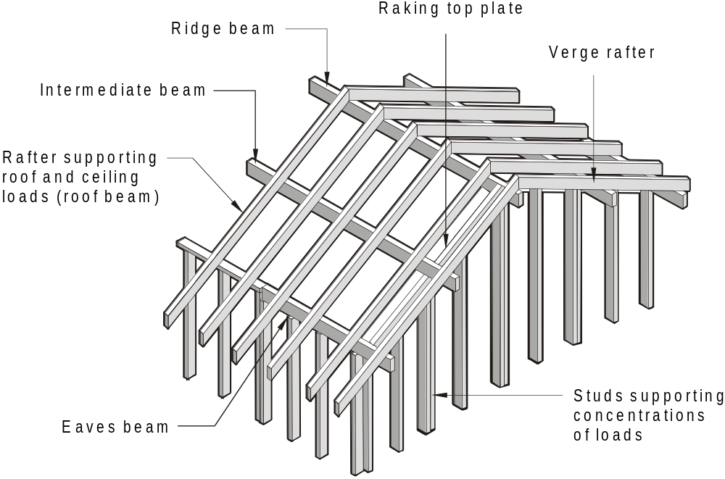
FIGURE 2.5 FRAMING MEMBERS —
CATHEDRAL ROOF CONSTRUCTION

Slide 15
7.1.2.4 Trussed roof
The design of a timber roof truss shall be in accordance with engineering principles and AS 1720.1. The wind design criteria shall be consistent with that used in this Standard (see Clause 1.6).
AS 4440-1997 Installation of nail-plated timber trusses should be referenced for correct practices when installing roof trusses.

Slide 16
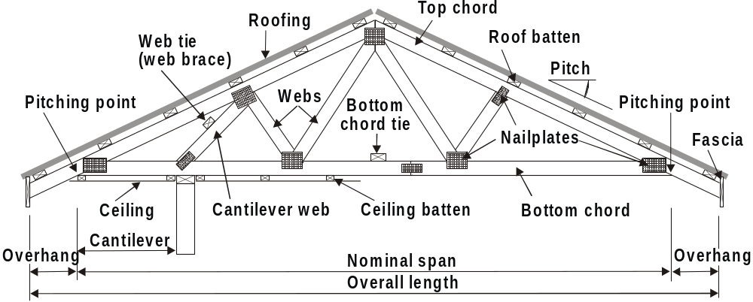
TERMS APPLYING TO TIMBER TRUSSES

Slide 17
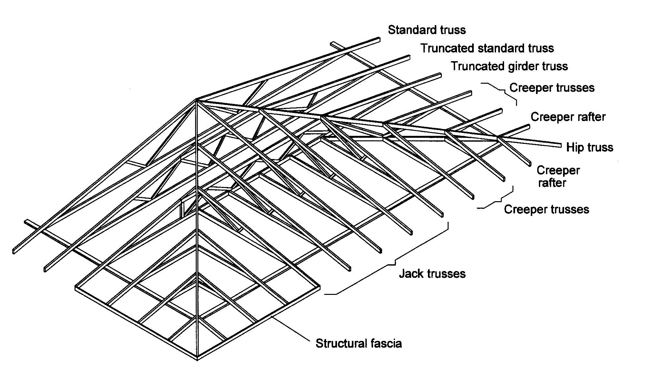
TERMS APPLYING TO ROOF TRUSS SYSTEM (HIP END)

Slide 18
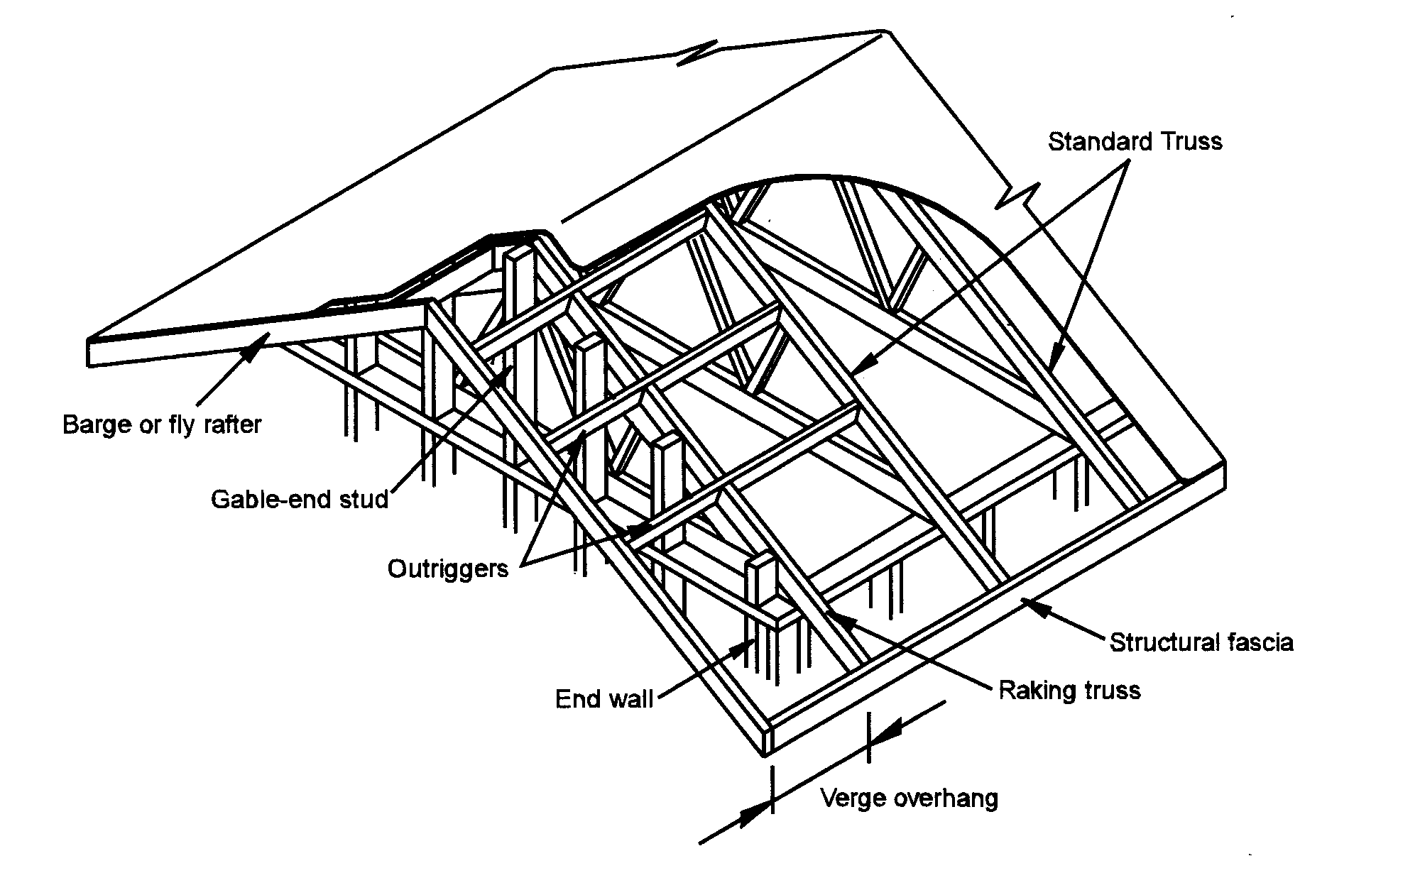
TERMS APPLYING TO ROOF TRUSS SYSTEM (GABLE END)

Slide 19
TYPICAL CONNECTION DETAILS

Slide 20
ROOF FRAMING
7.2 BUILDING PRACTICE

Slide 21
7.2.1 Ceilings
Ceilings may be fixed to the underside of ceiling joists, rafters or purlins or the bottom chord of trusses, with or without battens.

Slide 22
7.2.2 Construction loads on
ceiling framing
Ceiling joist sizes determined in accordance with the Span Tables in the Supplements shall not be used to support construction loads or the loads of workers until the joists are adequately fixed and laterally restrained by the installation of ceiling lining or ceiling battens (see also Clause 7.3.4), or until the construction planks are used on the top of ceiling joists during construction, to support workers.
A3

Slide 23
7.2.2 Construction loads on
ceiling framing
Ceiling battens shall not support construction loads or the loads from workers.
Note deleted
A3

Slide 24
7.2.3 Ceiling battens
Where ceiling battens are used, the size and fixings shall be appropriate for the mass of the ceiling material used, to provide a flat finish to the ceiling.

Slide 25
7.2.4 Ceiling joist
7.2.4.1 General
Ceiling joists shall be at spacings to support ceiling linings.
If ceiling linings are fixed directly to the ceiling joist, the joist need to be spaced according to the ceiling manufacturers recommendations, however if ceiling lining is fixed to battens, then the ceiling battens are sized according to the spacing of the ceiling joist.

Slide 26
7.2.4.1 General
For coupled roofs, ceiling joists shall be in single lengths or spliced in accordance with Clause 7.2.4.2 , and at the same spacing and in the same direction as the main rafters so that they may be fixed to and act as ties between the feet of pairs of opposing rafters.

Slide 27
7.2.4.1 General
Intermediate ceiling joists may be required to support ceiling linings.
End bearings of joists shall be the full width of the supporting wall plate except as provided for in Clause 7.2.4.2.

Slide 28
7.2.4.2 Splices and joints in coupled roofs
See Clause 7.1.2.1
A4

Slide 29
7.2.4.2 Splices and joints in coupled roofs
Lapped ceiling joists, or both ends of the butted ceiling joists to fishplates shall be secured with at least six hand-driven nails, or 8/3.05 mm diameter machine-driven nails, or with an M12 bolt (see Section 9).
Engineered nailplated joists shall be spliced and supported in accordance with the manufacturer’s recommendations.

Slide 30
7.2.4.3 Connection to hanging beams
Ceiling joists shall be fixed to hanging beams using a minimum of 35 × 32 mm timber cleats, 25 × 1.6 mm galvanized steel strapping, steel ceiling joist hangers or equivalent approved fasteners. Each alternate connection shall be fixed to opposite sides of the hanging beam (see Figure 7.3).

Slide 31
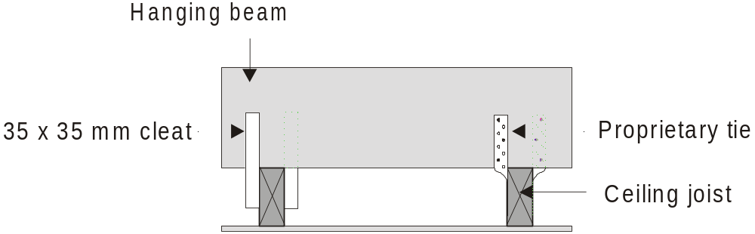
32
FIGURE 7.4 CEILING JOIST TO HANGING BEAM
(FIGURE 7.4 FIXING HANGING BEAM TO COUNTER BEAM )

Slide 32
7.2.4.3 Trimming around openings
In a joisted ceiling, any opening (manholes, skylights and the like) shall be trimmed to provide full support for ceiling linings. Where no loads other than normal ceiling loads shall be carried, trimmers shall be as follows:

Slide 33
7.2.4.4 Trimming around openings
(a) Openings up to 1000 mm — same size as ceiling joist.
(b) Openings greater than 1000 mm and up to a maximum of 3000 mm — breadth of trimmer to be increased by 20% for each 300 mm greater than 1000 mm. Members shall be connected by framing brackets.
(c) Openings greater than 3000 mm — trimmer size as for hanging beams.

Slide 34
7.2.4.4 Platforms in roof spaces
Ceiling joists shall support ceiling loads only. Any platforms constructed in the roof space above a ceiling for the support of a storage water heater, feed tank, flushing cistern, or the like, shall be designed for these loads.
The supporting walls also need to be designed for these loads.

Slide 35
7.2.5 Hanging beams
7.2.5.1 General
Hanging beams shall only support ceiling joists, and the attached ceiling materials.
Hanging beams are usually at right angles (or may be angled or placed off centre) to ceiling joists and are located directly above them (see Figure 7.2).
For beams supporting roof and ceiling loads, see Clauses 7.2.7 and 7.2.8.

Slide 36
7.2.5.2 End support of hanging beams
Hanging beams shall be held in a vertical position at both ends by nailing or bolting to an available rafter, gable end struts or by means of angle strutting from internal walls -

Slide 37
7.2.5.2 End support of hanging beams
End-bearings of hanging beams shall be the full width of the wall plate. Where hanging beams span 3.0 m or more, they shall be located directly above a stud, or the plates shall be stiffened (see Figure 6.8).
Where hanging beams are used as lateral binders, the connection to the external walls shall be equivalent to that shown in Figure 6.10.

Slide 38
7.2.5.2 End support of hanging beams
Where the slope of rafters is such that the depth of a hanging beam shall be reduced by more than two-thirds in order to avoid interference with roof cladding, provision shall be made for additional support incorporating a jack ceiling joist (trimmer) as shown in Figure 7.3.

Slide 39
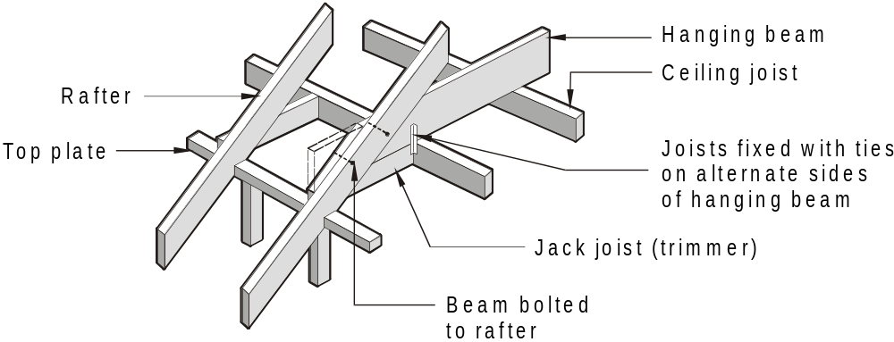
FIGURE 7.3 SUPPORT OF HANGING BEAM
WITH JACK CEILING JOIST (TRIMMER)

Slide 40
7.2.6 Counter beams
7.2.6.1 General
Counter beams may be provided to support hanging beams (see Figure 7.2 and 7.4). End support of counter beams shall be similar to that for hanging beams (see Clause 7.2.5.2).
Where roof loads are required to be supported on counter beams they shall be designed as combined strutting/counter beams (see Clause 7.2.8).

Slide 41
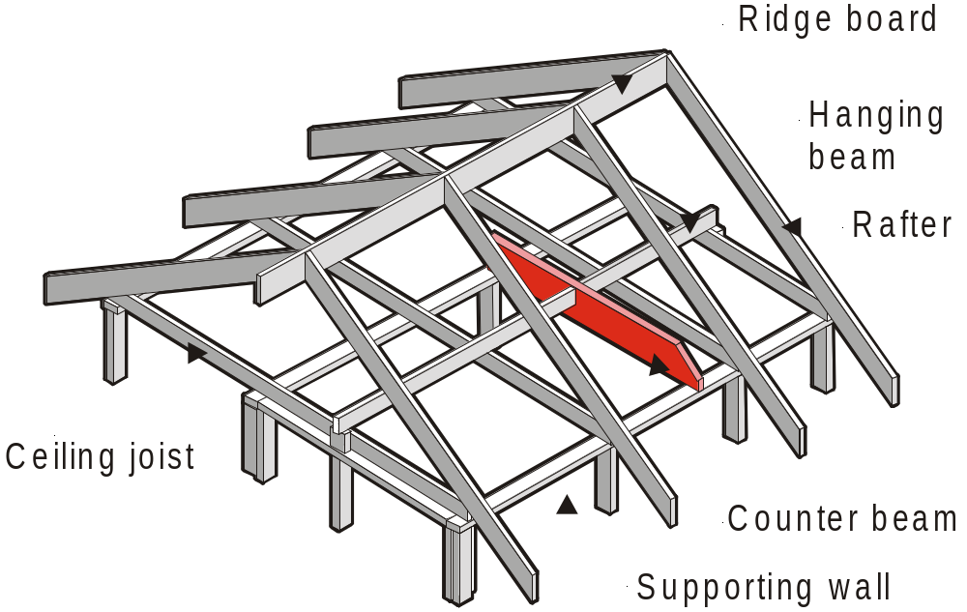
FIGURE 7.2 COUNTER BEAM SUPPORTING HANGING BEAMS

Slide 42
7.2.6.1 Intersection of hanging
and counter beam
At intersections of hanging and counter beams, the hanging beam may be checked out over the counter beam, or butted up to the counter beam. The hanging beams shall be supported by 45 × 42 mm minimum ledgers fixed at each side of the counter beam with 5/3.05 mm diameter nails or 2/No. 14 Type 17 screws, or by other proprietary connectors such as joist hangers (see Figure 7.4).
A4

Slide 43
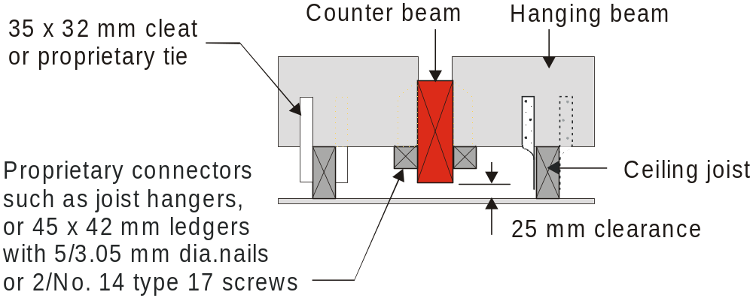
A2
A4
FIGURE 7.4 FIXING HANGING BEAM TO COUNTER BEAM

Slide 44
7.2.7 Combined strutting/hanging beams
Combined strutting/hanging beams shall be at right angles to rafters and ceiling joists.
End supports shall be as for strutting beams (see Clause 7.2.9).
NOTE: 1
The clearance requirements specified for the strutting beam are not necessary*, as the hanging beam is located directly over the ceiling joists.

Slide 45
* The clearance that is required for strutting beams (see 7.2.9) should also be used for combined hanging/strutting beams so that any initial deflection after the roof is loaded is not transferred to the ceiling. The cleats (hangers) should be fixed to the ceiling joist after the roof is loaded and with a slight camber up to allow for some longer term ‘settling’. (If the cleats must be fixed before the roof is loaded, increase the camber.)

Slide 46
7.2.7 Combined strutting/hanging beams
NOTE: 2
Combined strutting/hanging beams support both roof and ceiling loads. Roof loads are placed onto the beam by roof struts and ceiling loads are as for hanging beams (i.e. joists suspended on cleats).

Slide 47
7.2.8 Combined strutting/counter beams
Combined strutting/counter beams shall be used to support roof loads and ceiling loads via hanging beams. They shall be located at right angles to hanging beams and parallel to ceiling joists.

Slide 48
7.2.8 Combined strutting/counter beams
At intersections of hanging beams and combined strutting/counter beams, the hanging beam may be checked out over or butted up to the strutting/counter beam. It shall be supported by 45 × 42 mm timber ledgers fixed at each side of the strutting beam or by other proprietary connectors such as joist hangers. See Figure 7.4 for a similar detail.

Slide 49
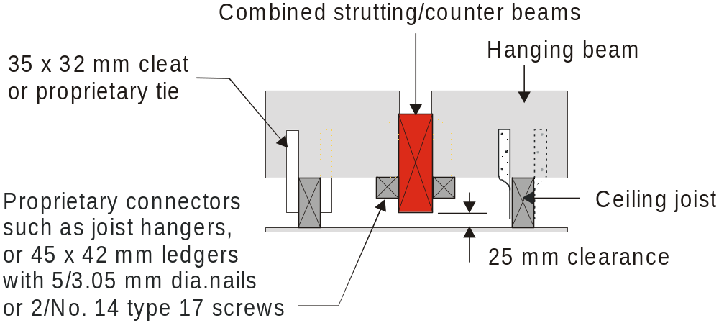
FIGURE 7.4 FIXING HANGING BEAM TO
COMBINED STRUTTING/COUNTER BEAM

Slide 50
7.2.8 Combined strutting/counter beams
For end supports, see Clause 7.2.9. - (Ends of strutting beams shall bear on the full width of wall plates.)
Where counter beams are located between the ceiling joists, the 25 mm clearance specified for strutting beams is required.

Slide 51
7.2.9 Strutting beams
Ends of strutting beams shall bear on the full width of wall plates.
Strutting beams shall support roof loads only. They may extend in any direction in the roof space.

Slide 52
7.2.9 Strutting beams
Beams shall bear directly above studs supporting concentrated loads or distributed over two or more studs by means of top plate stiffening (see Figure 6.8).
Where strutting beams occur over openings, the lintels shall be designed for a concentrated load.

Slide 53
7.2.9 Strutting beams
Blocking shall be provided between strutting beams and wall plates to provide an initial clearance of 25 mm at midspan between the underside of the beams and the tops of ceiling joists, ceiling lining or ceiling battens, as appropriate (see Figure 7.5).
The reason for this clearance is to allow the strutting beam to deflect when the roof is ‘loaded’ and for some longer term ‘settling’, without affecting the ceiling. (The allowable deflection limit for a strutting beam is Span/300 or 20mm).

Slide 54
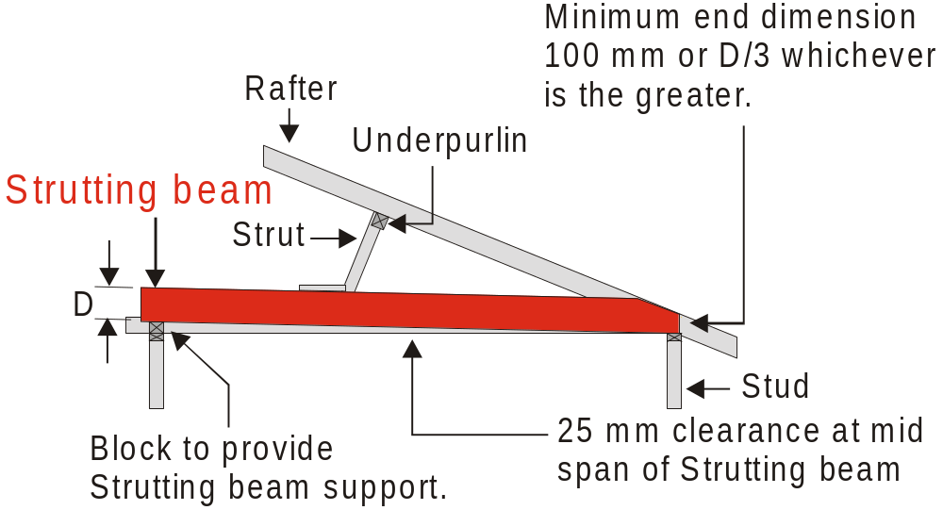
FIGURE 7.5 INSTALLATION OF STRUTTING BEAMS

Slide 55
7.2.9 Strutting beams
The ends of strutting beams may be chamfered to avoid interference with the roof claddings. Where the end dimension is less than 100 mm, or one-third the beam depth, whichever is greater, an alternative support method shall be provided similar to that shown for hanging beams (see Figure 7.3).

Slide 56
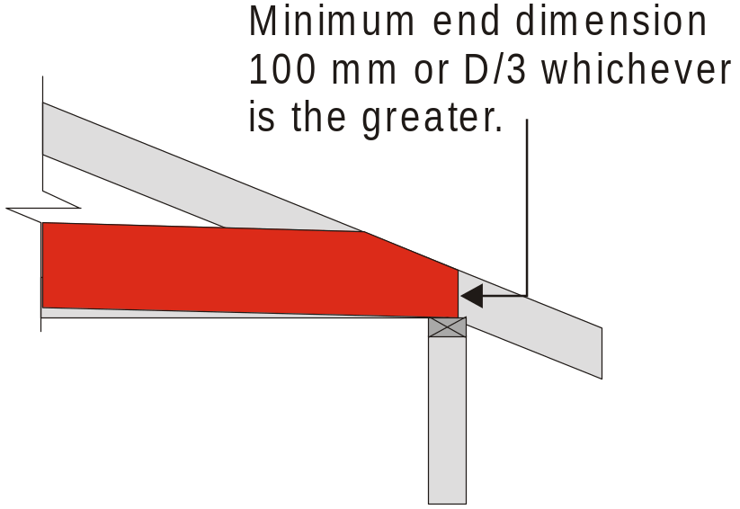
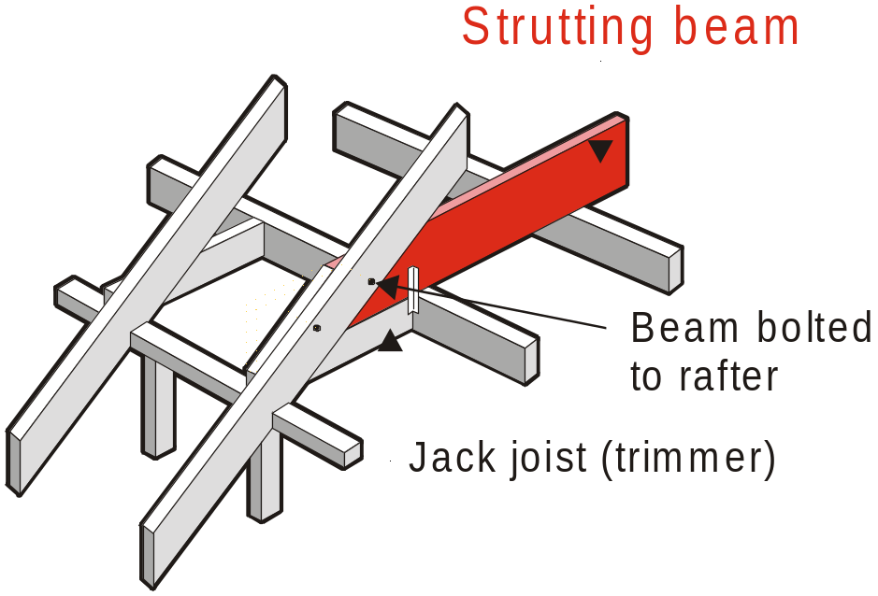
Ends of strutting beams chamfered to avoid interference with the roof claddings.
OR where the end dimension is less than 100 mm, or one-third the beam depth the alternative support method shall be similar to that shown for hanging beams (see Figure 7.3).

Slide 57
7.2.10 Underpurlins
7.2.10.1 General
Underpurlins shall be in single lengths where possible and shall be in straight runs at right angles to the direction of rafters.
Where two or more rows of underpurlins are required they shall be spaced evenly between the ridge and the wall’s top plates.

Slide 58
7.2.10.2 Joins in underpurlins
Where underpurlins are joined in their length, the joint shall be made over a point of support, with the joint halved, lapped and nailed.

Slide 59
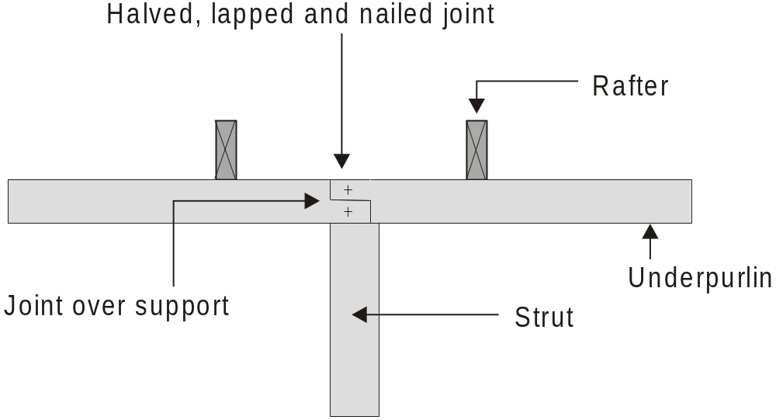
FIGURE 7.6 JOINING UNDERPURLINS
Some other, and generally more popular methods of joining underpurlins are those used for joining floor joist. e.g. lapped, butted with a timber cleat (‘fish plate’) and the alternate method shown for floor joist – a vertical scarf.

Slide 60
7.2.10.3 Cantilevered underpurlins
The ends of an underpurlin may project (cantilever) beyond a support by up to 25% of the maximum allowable span of the underpurlin, provided the actual backspan is at least three times the cantilever length.

Slide 61
7.2.10.4 Support of underpurlins
Underpurlins shall be securely fastened to hip or valley rafters as shown in Figure 7.7, or by a method providing equivalent support.
Where underpurlins support a hip or valley rafter, an additional metal angle, nailplate or similar bracket shall be installed to connect the side of the underpurlin to the hip or valley rafter.

Slide 62
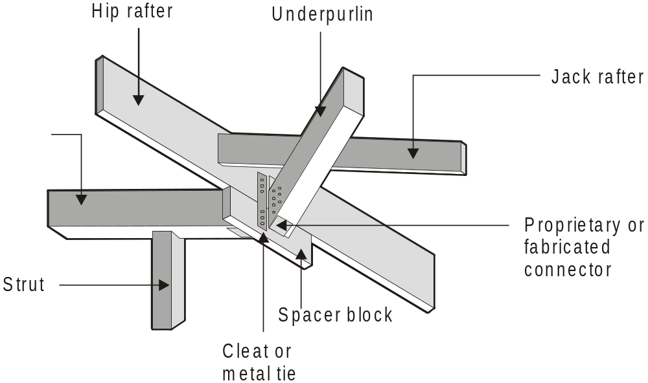
FIGURE 7.7 TYPICAL UNDERPURLIN CONNECTION
TO HIP OR VALLEY

Slide 63
7.2.10.4 Support of underpurlins
Where underpurlins are not strutted at junctions with hip or valley rafters and the allowable underpurlin cantilever is exceeded, the underpurlins shall be considered to be supported by the hip or valley rafters (see Clause 7.2.13).
Where the hip or valley rafters support the underpurlin, the underpurlin shall be fixed to the hip or valley rafter using framing anchors.

Slide 64
7.2.11 Rafters
7.2.11.1 General
Rafters shall be single length members or joined over supports.
For joining rafters, refer to Clause 7.1.2.1

Slide 65
7.2.11.1 General
Rafters in cathedral roofs are to be designed to carry both roof and ceiling loads.
Rafters/Purlins that support ceiling loads, as well as roof loads shall be designed as rafters/purlins with ceiling attached.

Slide 66
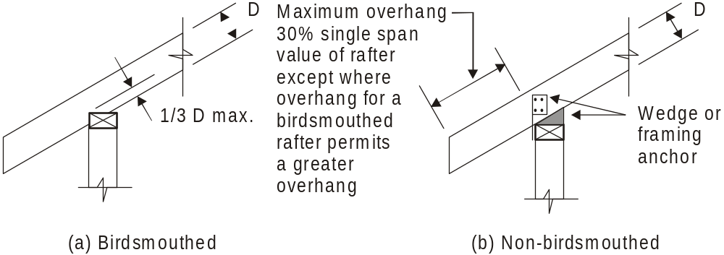
7.2.11.2 Birdsmouthing
Rafters may be birdsmouthed to a depth not exceeding one third of the rafter depth (see Figure 7.28).
A1
FIGURE 7.28 RAFTER OVERHANG AND BIRDSMOUTHING

Slide 67
7.2.12 Ridgeboards
7.2.12.1 General
Ridgeboards shall be provided to locate and stabilize rafter ends. Opposing pairs of rafters shall not be staggered by more than their own thickness at either side of their ridge junction.
Ridgeboards shall only be used in coupled roof construction.
The size of ridgeboards shall be determined from Table 7.6.

Slide 68
7.2.12.1 General
Junctions of ridgeboard and hip or valley rafters shall be strutted where the hip or valley rafters exceed 5 m span, or where underpurlins are supported off hip or valley rafters.
If strutting of the junction of ridgeboard and hip or valley rafter is required, the remainder of the ridge generally will also need to be strutted.

Slide 69
7.2.12.1 General
Where a ridgeboard is required to be strutted along its length, but there are insufficient strutting supports, the ridgeboard shall be designed as a ridge beam for an uncoupled roof, or alternative provisions shall be made for the full support of the roof loads.
NOTE: An example of an alternative would be the provision of a tie-bolt truss.

Slide 70

The strutting of ridges should be avoided when ever possible.
This is because a pitched roof will tend to drop slightly due to timber movement and/or the tightening of joints after the roof load is applied - shrinkage of unseasoned timber will add to this.
Generally, a pitched roof without ridge struts,
the whole roof will tend to drop slightly.
If the ridge is strutted, movement/shrinkage is restricted at this point and the roof may show a ‘sag’ between the ridge and the top plates.

Slide 71
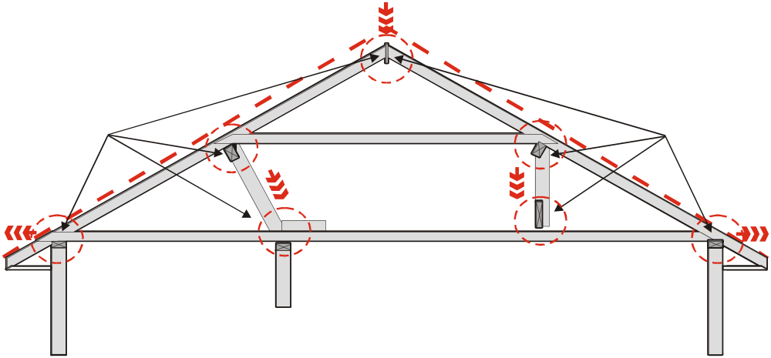
Without ridge struts -
the whole roof will tend to drop slightly & the roof remains relatively ‘straight’.
Movement / tightening of joints & movement / shrinkage of
timber.
Movement / tightening of joints & movement / shrinkage of
timber.

Slide 72
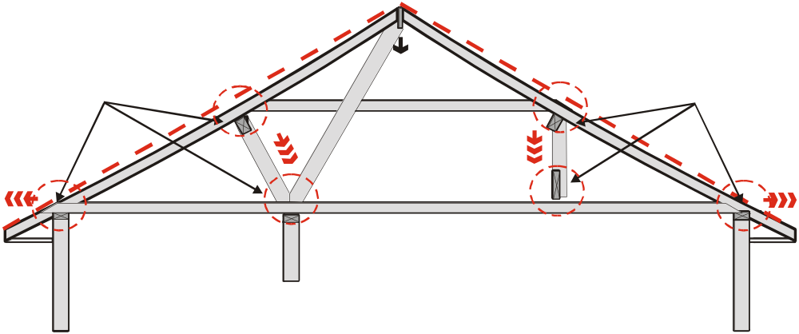
With ridge struts -
roof may develop a noticeable ‘sag’ between the ridge and the top plates.
Movement/shrinkage is restricted at the ridge due to the struts.
Movement / tightening of joints & movement / shrinkage of
timber.
Movement / tightening of joints & movement / shrinkage of
timber.

Slide 73
7.2.12.2 Joins in ridgeboards
Ridgeboards may be joined using a scarf joint at the abutment of a rafter pair or, preferably, nail spliced (minimum of 6 nails per side of splice) using full depth fishplates on both sides of the ridgeboard (see Figure 7.8).
NOTE: Full length ridgeboards should be used wherever possible.

Slide 74
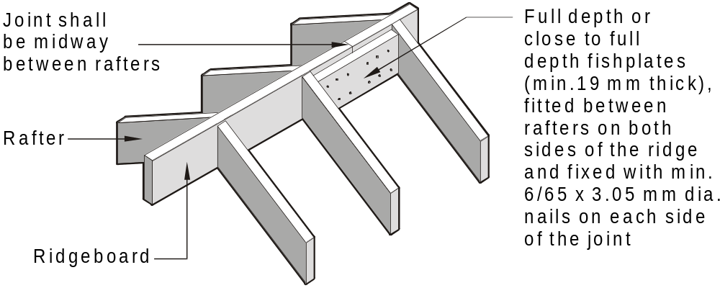
FIGURE 7.8 FISHPLATED RIDGEBOARD SPLICE

Slide 75
7.2.13 Hip and valley rafters
Where strutting points are available, hip and valley rafters shall be supported by struts at the same number of equally spaced intermediate points as for common rafters.
Where strutting points are not available, hip rafters shall be supported by an underpurlin in at least one direction, and valley rafters shall be supported by underpurlins in both directions.
A2

Slide 76
7.2.13 Hip and valley rafters
Where the underpurlins are supported by the hip or valley rafters, a tie-bolt truss system, as shown in Figure 7.14, may be installed, (refer manufacturer’s specifications) or the hip or valley rafter may be designed to support the underpurlin loads.
There is no guidance given on designing hips to support underpurlin loads in AS1684, engineering advice is needed.

Slide 77
7.2.13 Hip and valley rafters
This may be used where the underpurlins cantilever beyond a strut by more than 25% of the maximum span, and no strutting point is available at the junction of the hip or valley and underpurlin.
A strut shall be used at the intersection of the hip or valley and ridgeboard when the hip or valley rafters support the underpurlin.

Slide 78
7.2.13 Scotch valleys
Where ‘scotch valley’ construction (see Figure 2.4) is used at the junction of two roof surfaces, the pitching plate to which creeper rafters of the secondary roof are fixed shall be securely nailed at each common rafter crossing. The pitching plate shall be minimum 35 mm thick by such width as will provide adequate bearing for the feet of creepers.

Slide 79
7.2.15 Roof strutting
7.2.15.1 Roof struts
Where necessary, struts shall be provided to support roof members, such as underpurlins ridgeboards and hip and valley rafters. Struts shall be supported off walls, strutting beams or combined hanging/strutting beams.
Struts shall not be supported on hanging or counter beams. (or ceiling joist, except at points of support, or binders.)

Slide 80
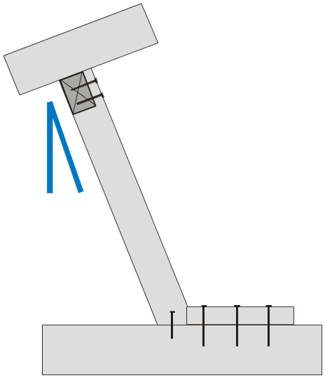
7.2.15.1 Roof struts
Except as provided for in Clauses 7.2.15.2, 7.2.15.3 and 7.2.15.4, struts shall be either vertical or perpendicular to the rafters or at an angle not exceeding 35° to the vertical* and they shall be birdsmouthed or halved to underpurlins as shown in Figure 7.9.
* refers to this angle 35^{O} max.

Slide 81
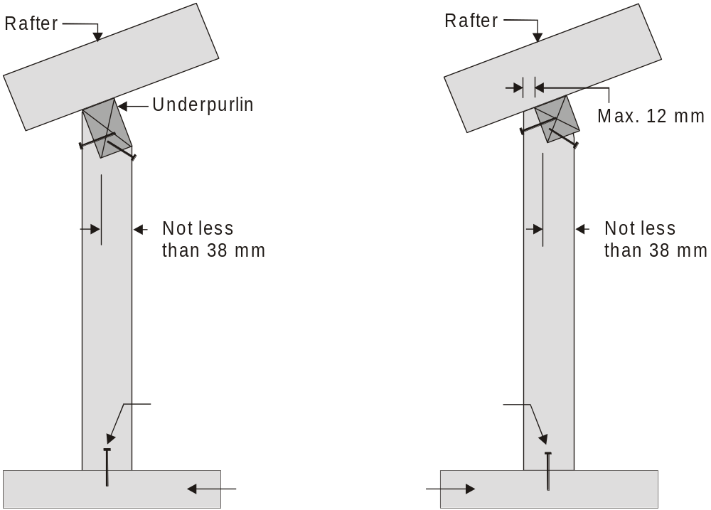
2/75 mm
skew nails
2/75 mm
skew nails
Firm base for nailing
e.g. strutting beam,
top plate etc.
FIGURE 7.9 VERTICAL STRUTS

Slide 82
7.2.15.1 Roof struts
Studs supporting struts shall be determined in accordance with Clause 6.3.2.2 or Clause 6.2.2.3 as appropriate.
Struts that are not vertical shall be restrained by blocks or chocks, as shown in Figure 7.10.
A2

Slide 83
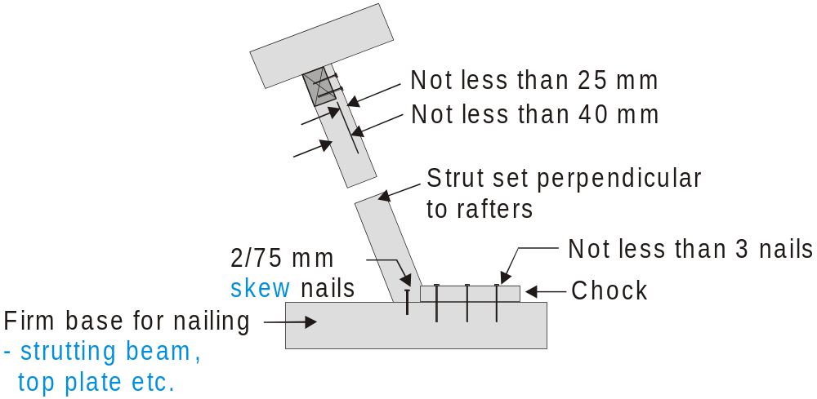
FIGURE 7.10 STRUTS PERPENDICULAR TO RAFTERS

Slide 84
7.2.15.2 Tied and braced strut system
Where struts are located at an angle exceeding 30° to the vertical, and do not have an opposing strut as per Clause 7.2.15.4 an d Figure 7.13, they shall be tied and braced to form a frame in accordance with Figure 7.11, or they shall be in accordance with Clause 7.2.15.4.

Slide 85
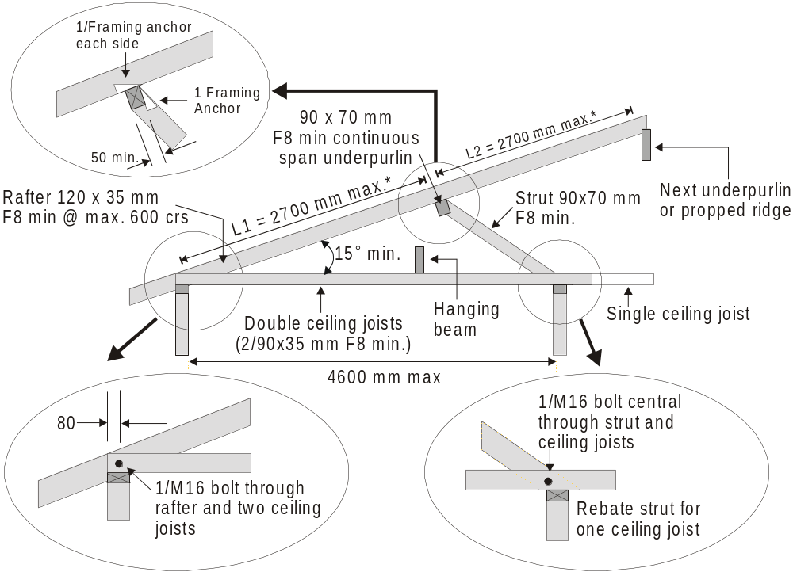
FIGURE 7.11 TIED ROOF STRUTS
Length of L1 shall be between L2 and 1.25 times L2

Slide 86
7.2.15.3 Fan struts
A pair of struts (fan or flying struts) may be used in the same line as, or perpendicular to, the underpurlin with their supports opposing each other. The pair of struts shall be at the same angle, and not greater than 45° to the vertical (see Figure 7.12).
Maximum fan strut length is 4.5 m with maximum 3.0 m spacing between the struts and underpurlin connection.

Slide 87
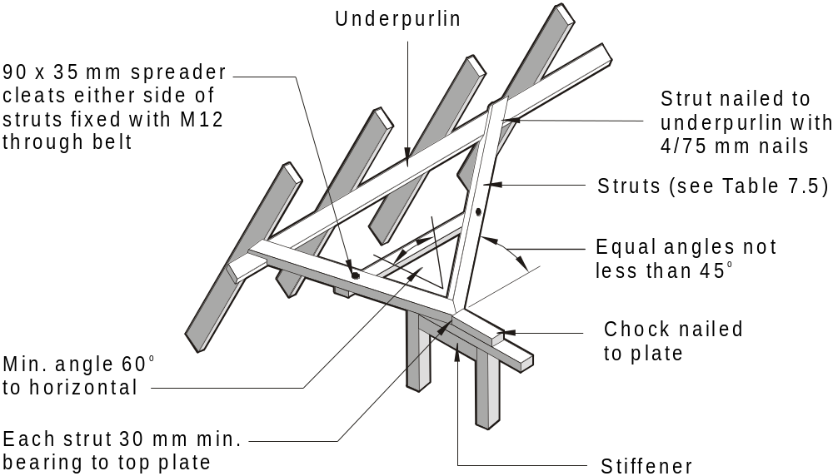
FIGURE 7.12 FAN OR FLYING STRUTS

Slide 88
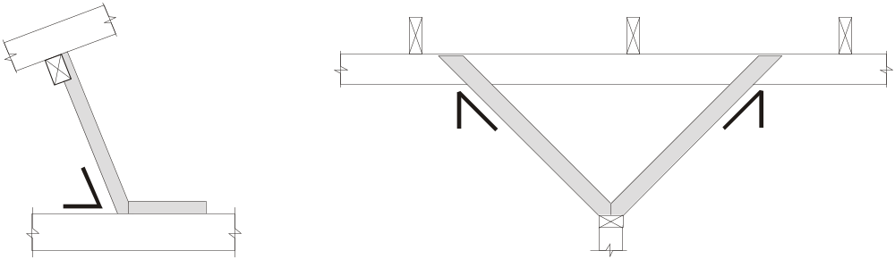
7.2.15.3 Fan struts
60^{O} max.
45^{O} max.
45^{O} max.
EQUAL

Slide 89
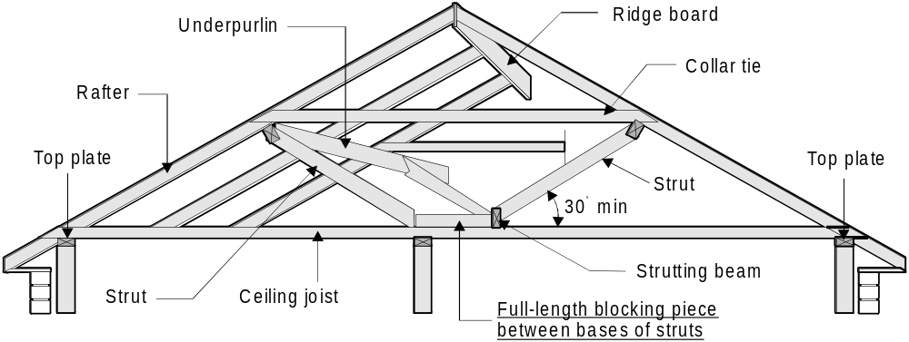
7.2.15.4 Opposing struts
Where roofs are strutted using opposing struts, they shall comply with Figure 7.13.
A2
Provide 25mm clearance between strutting beam and ceiling joist
FIGURE 7.13 OPPOSING STRUTS

Slide 90
7.2.16 Collar ties
Collar ties shall be provided in all coupled roof construction. See Table 7.6 for size of collar ties.
Where the rafter span is such as to require support from underpurlins, collar ties shall be fitted to opposing common rafters at a point immediately above the underpurlins.
A1

Slide 91
7.2.16 Collar ties
Where underpurlins are not required, the collar ties shall be fitted to opposing rafters at a height above the top plate not greater than two-thirds of the rise of the roof.
Collar ties shall be fitted to every second pair of common rafters, or at 1200 mm maximum spacing, whichever is the lesser.
Rafters at more than 600 mm spacing therefore require a collar tie at each pair of rafters.

Slide 92
7.2.16 Collar ties
Collar ties shall be fixed to rafters with one M10 bolt for ties greater than 4.2 m long or min. 2/75 hand-driven nails, or
3/75 × 3.05 mm ∅ machine-driven nails for ties up to 4.2 m long.

Slide 93
7.2.17 Hip ends
Hip ends shall be constructed in accordance with the alternative methods shown in Figure 7.14.

Slide 94
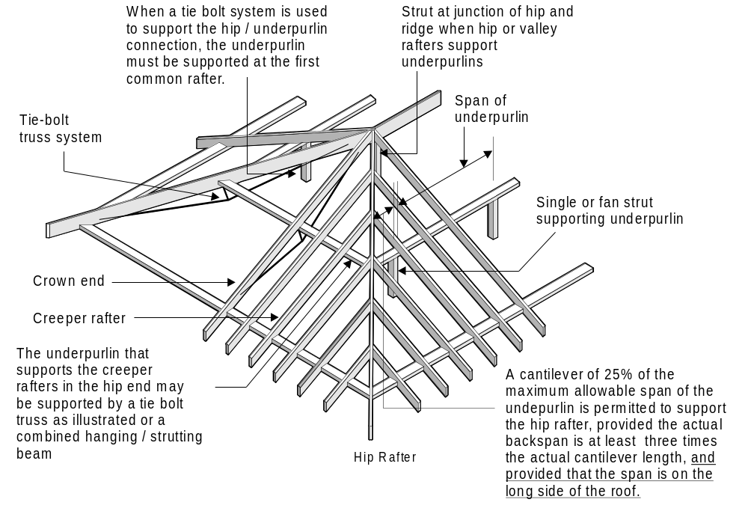
A2
FIGURE 7.14 HIP END

Slide 95
7.2.18 Alternative support systems
Where shown to be suitable through engineering design principles, tie-bolt trusses or other alternative support systems may be used in combination with underpurlins, hip or valley rafters or common or jack rafters, as appropriate.

Slide 96
7.2.19 Non-coupled roofs
7.2.19.1 General
Non-coupled roofs shall have rafters, or raking roof beams, supported off walls, ridge beams and/or intermediate beams.
This roof system includes cathedral roofs (ceiling in line with roof) as well as other raftered roofs outside the limits for ‘coupled roof construction’ (e.g. roof pitch below 10°).

Slide 97
7.2.19.1 General
Rafters or raking roof beams to cathedral roofs shall be designed to support roof and ceiling loads.
Studs supporting ridge or intermediate beams shall be designed as ‘supporting concentration of load’ or as posts.

Slide 98
7.2.19.2 Ridge and intermediate beams
Ridge beams or walls shall be provided at the apex in the roof and shall be designed to support roof loads and ceiling loads (where required).
Ridge beams shall be at right angles to the rafters and shall be continuous to points of support. They shall be placed either under the rafters or positioned between pairs of rafters as for a ridgeboard.

Slide 99
7.2.19.2 Ridge and intermediate beams
Intermediate beams shall be provided where required between the ridge and top plate of the wall.
Intermediate beams shall support the rafters (and ceiling loads where required), and shall be at right angles to the rafters.

Slide 100
7.2.20 Roof battens
Where possible, battens shall be continuous spanned and joined over supports.
AS1684 only gives one specific method of joining battens and that is where battens are butt-joined between supports.
There are many other ways of joining battens, however the uplift capacities of the batten fixings used with most other joining methods may need to be reduced due the reduction in end distances achieved.

Slide 101
7.2.20 Roof battens
Where battens are butt-joined between supports, they shall be spliced using a minimum 600 mm long fishplate of the same size and grade as the batten.
The fishplate shall be screw-fixed to the side or underside of the batten using 2/No. 14 type 17 screws each side of the butt joint.
The screws shall be positioned not more than 75 mm from the ends of the fishplate and butt joint.

Slide 102
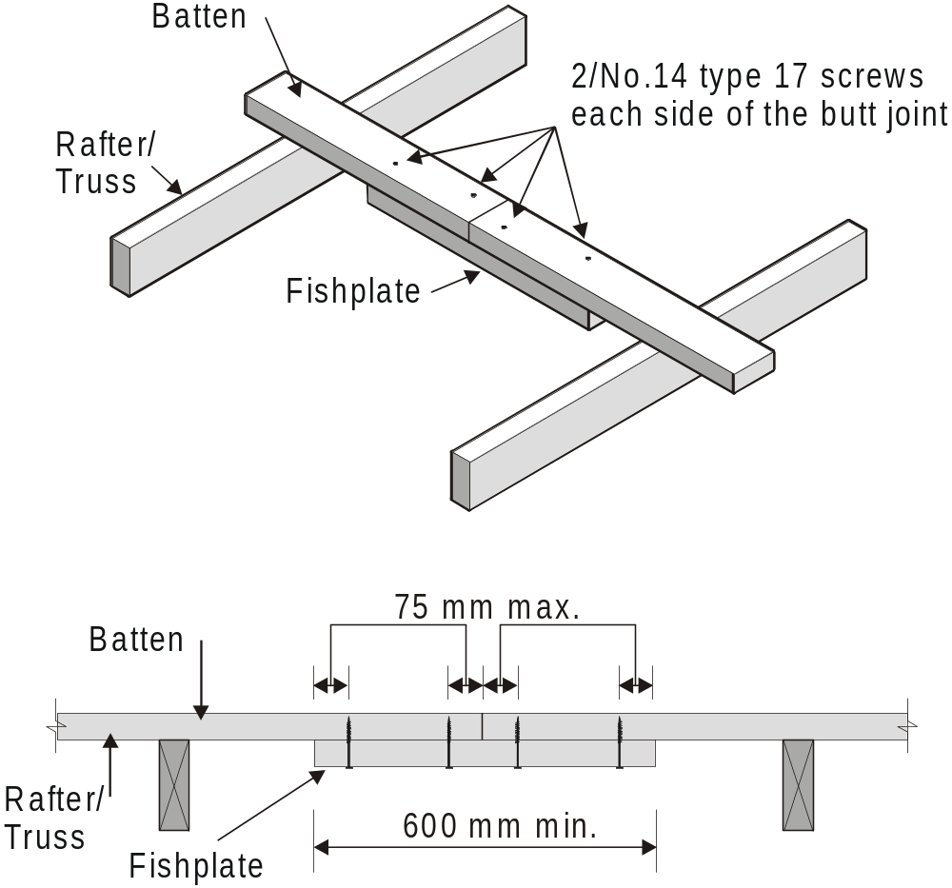
NOTE: The full uplift capacities of the batten fixings given in Table 9.25 can be used with this batten join.
BATTEN BUTT-JOINED BETWEEN SUPPORTS

Slide 103
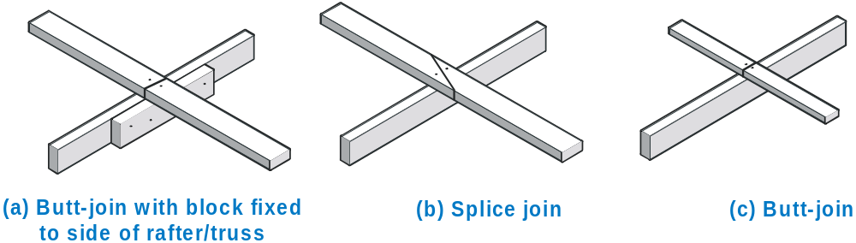
EXAMPLES OF OTHER TYPES OF BATTEN JOINS
NOTE: The uplift capacities of the batten fixings given in Table 9.25 when used with these and most other batten joins may need to be reduced in proportion to any reduction in end distances of the fixings.

Slide 104
7.2.21 Trussed roofs
7.2.21.1 General
Trusses shall be handled, erected, installed and braced in accordance with AS 4440. Trusses shall be designed in accordance with engineering principles.

Slide 105
7.2.21.2 Structural fascias
A structural fascia that is capable of distributing overhang loads to adjacent trusses shall be installed.
A minimum timber (softwood) structural fascia of 190 × 19 mm shall be used.
NOTES:
1 Other fascias or combinations of members with similar stiffnesses may be used.
2 Grooves in fascia to accept eaves lining are permitted.

Slide 106
7.2.21.3 Truss layout
Placement of trusses shall be strictly in accordance with the truss design.

Slide 107
7.2.21.4 Support of trusses
Loadbearing walls supporting trusses shall be in accordance with Section 6.
Girder trusses shall be considered concentrations of load and supported as outlined in Section 6. Lintels supporting girder trusses over openings shall be designed as lintels supporting point loads.
Trusses shall not be supported off internal walls unless the wall and the truss are specifically designed for the purpose.

Slide 108
7.2.22 Bracing for raftered and trussed roofs
All roof frames shall be adequately braced to withstand horizontal forces applied to the building. Bracing shall be designed and fixed to transfer any loads to the supporting structure (see Section 8).

Slide 109
7.2.23 Fixing of ceiling framing to internal bracing walls
All bracing walls shall be fixed to ceiling or roof framing and/or to the external wall frame (see Clause 8.3.6.9).

Slide 110
7.2.24 Eaves construction
7.2.24.1 General
Where fascias and bargeboards are used as a structural member to support roof loads, the size shall be determined as either for a rafter or verandah beam.

Slide 111
7.2.24.2 Boxed eaves
Soffit bearers used in the construction of boxed eaves shall be spaced to suit eaves lining and shall be not less than the following sizes:
(a) 45 × 32 mm where the span does not exceed 600 mm.
(b) 70 × 35 mm where their span is greater than 600 mm but not greater than 1.5 m.

Slide 112
7.2.24.2 Boxed eaves
In masonry veneer buildings, the inner ends of soffit bearers shall either be supported by means of minimum 45 × 19 mm hangers from rafters (see Figure 7.15(a)), or shall be fixed to the external wall studs (see Figure 7.15(b)).

Slide 113
7.2.24.2 Boxed eaves
In the case of masonry veneer buildings where soffit bearers are supported by the wall frame, a minimum 12 mm clearance shall be provided between the soffit bearer and the top of the masonry to allow for frame shrinkage.
Where an unseasoned frame is used, the total shrinkage of wall frame, joist and bearers should be calculated and the apropriate clearance provided.

Slide 114
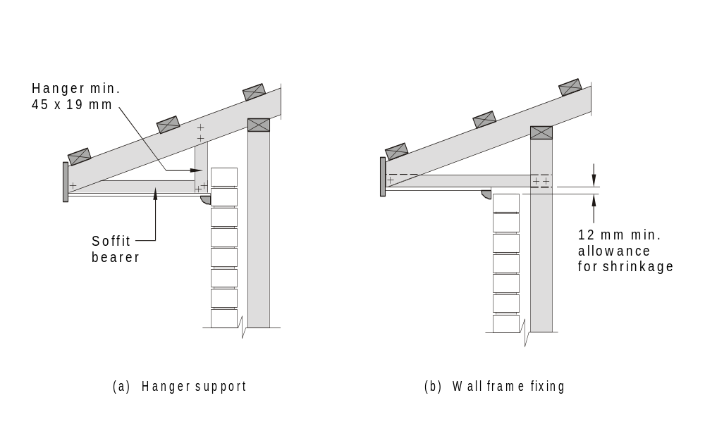
As per Note iv Table 29, overhang limits do not apply where rafter ends are tied back to wall frame.
FIGURE 7.15 BOXED EAVES CONSTRUCTION

Slide 115
7.2.25 Gable or verge construction
7.2.25.1 General
Gables or verges shall be formed either —
(a) with rafters supported on cantilevered extensions of ridgeboards or beams, underpurlins, intermediate beams and wall plates; or
(b) with outriggers or outriggers at right angles to and trimmed into common rafters or trusses, which shall be adequately fixed and nogged to prevent overturning and to provide fixing for roof battens.

Slide 116
7.2.25.1 General
Members cantilevered to support gables shall not project beyond their supports by more than 25% of the allowable span of the member and their backspan shall be at least twice that of the cantilever.

Slide 117
7.2.25.2 Open gables
Open gable end walls may be constructed using either —
(a) for exposed rafter (cathedral) roofs, studs continuous up to a raking top plate below rafters;
(b) for pitched roofs with a horizontal ceiling, gable end studs supported off the top plate; or
(c) gable trusses fully supported off the gable end wall, or raking truss (gable end truss) with gable end studs supported off the top plate (see Figure 7.16).
A2

Slide 118
7.2.25.2 Open gables
Gable end studs or additional vertical members and trusses shall be provided at the spacing required to fix cladding, or brick veneer where used, and shall be of sufficient size and stress grade to support dead, live and wind loads. For gable end studs, see Clause 6.3.2.5.
Open gable eaves may be unlined or may be sheeted on the upper side or the underside of rafters.
A1

Slide 119
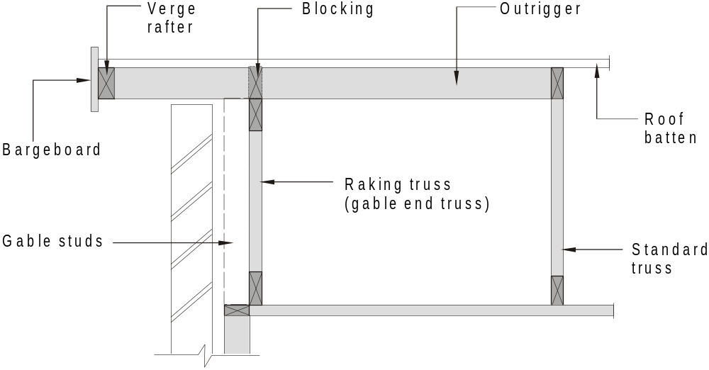
FIGURE 7.16 OPEN GABLE OR VERGE — TRUSSED ROOF

Slide 120
7.2.25.3 Boxed gables
Boxed gables shall have 70 × 35 mm soffit bearers fixed between the lower ends of gable studs or gable truss and the frame wall. Gable lining shall be fixed either directly to the gable truss or to the gable studs (see Figure 7.17).
Boxed gables shall be securely fixed off the structural wall plate with strutting or bracing as necessary to support the load of the gable framing and the roof covering.

Slide 121
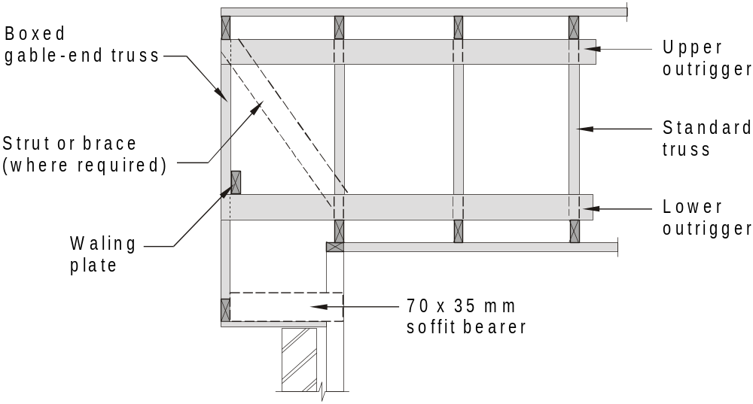
FIGURE 7.17 BOXED GABLE — TRUSSED ROOF

Slide 122
7.2.26 Lateral restraint of hanging, strutting, strutting/hanging beams, and the like
Where required, lateral restraint shall be provided by one of the methods shown in Figure 7.18.

Slide 123
(a) Block skew nailed to beam and to support with 3/75 mm skew nails to each member
(b) Min 35 × 32 mm tie nailed to top of beam and to support with 2/75 mm nails each end (see Note below)
(c) Galvanized strap nailed to support and top of beam with 2/30 × 2.8 mm nails each end and to beam (see Note below)
A2
NOTES:
1 Method used depends upon whether the ceiling joist are at 90^{O} or parallel to the beam.
2 Methods given in (b) and (c) are particularly suitable for restraining strutting beams and strutting/hanging beams at the intermediate points where the beams are supported, as they also permit these beams to be supported up clear of the ceiling joist by packing under at their supports.
FIGURE 7.18 LATERAL RESTRAINT
Note: For strutting beams and hanging/strutting beams, provide 25mm clearance to ceiling joist as per Clause 7.2.9.

Slide 124
7.2.27 Framing around chimneys
and flues
Placement of all framing members around chimneys and flues shall be in accordance with AS 1691 and AS 2918.
Also refer to BCA Housing Provisions - Part 3.7.3

Slide 125
ROOF FRAMING
7.3 MEMBER SIZES

Slide 126
7.3.1 General
Member sizes shall be determined from the Span Tables of the Supplements for coupled or non-coupled roof construction, as appropriate (see Clause 2.7.4).

Slide 127
7.3.2 Ceiling battens
For glued, or glued and screwed, or machine-driven nailed ceiling linings, the minimum ceiling batten sizes shall be in accordance with Table 7.1 for ceiling linings with a mass up to 12 kg/m².
For hand-driven nailed or hand-driven nailed and glued ceiling linings, batten sizes may need to be increased to avoid damage to ceiling lining or fixings due to flexibility.

Slide 128
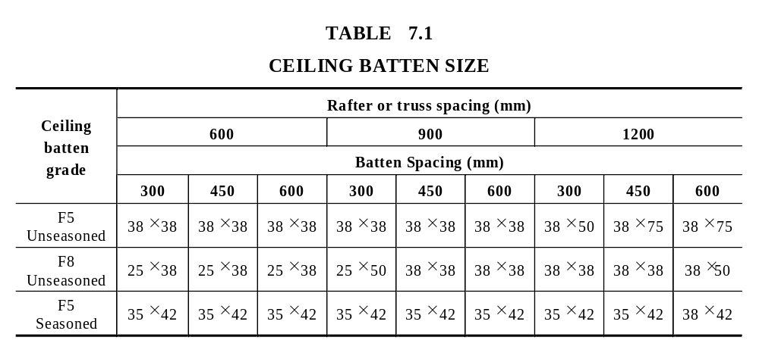

Slide 129
7.3.3 Ceiling lining and non- trafficable roof decking
7.3.3.1 General
Ceiling lining or non-trafficable roof decking shall be attached directly to rafters or purlins, the underside of ceiling joists, bottom or top chord of trusses or to battens to ensure the integrity of the roof and the ceiling diaphragm.

Slide 130
7.3.3.1 General
Suspended ceiling systems shall not be assumed to provide diaphragm action to transfer wind loads to bracing walls.

Slide 131
7.3.3.2 Tongue and groove non- trafficable roof decking
Tongued and grooved timber boards used for non-trafficable roofs shall be in accordance with Table 7.2.
Where boards are not at right angles to rafters, the board span shall be taken along the length of the board.

Slide 132
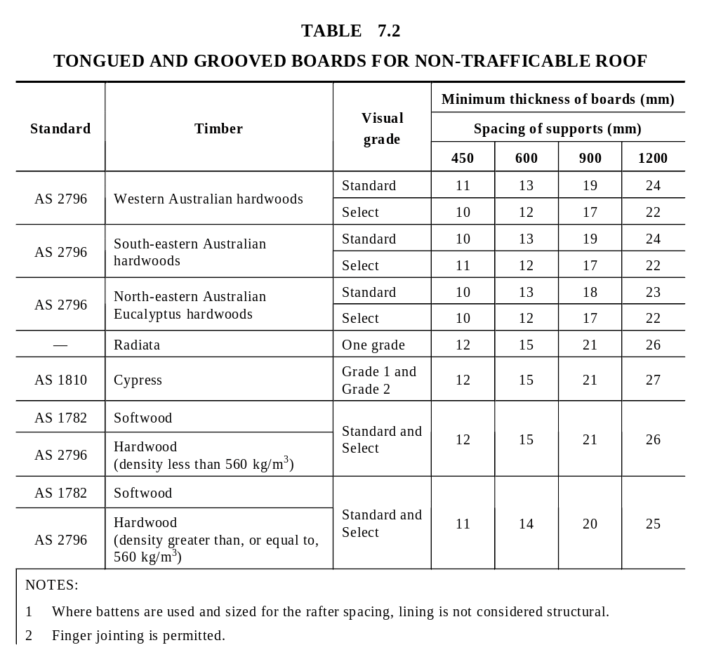

Slide 133
7.3.3.2 Structural plywood non- trafficable roof decking
Structural plywood used for non-trafficable roof decking shall be in accordance with Table 7.3.
Plywood sheets shall be laid with the grain of the face ply parallel to the span, and shall be continuous over at least two spans. Tabulated spacing shall be reduced by 25% if supported over one span only.

Slide 134
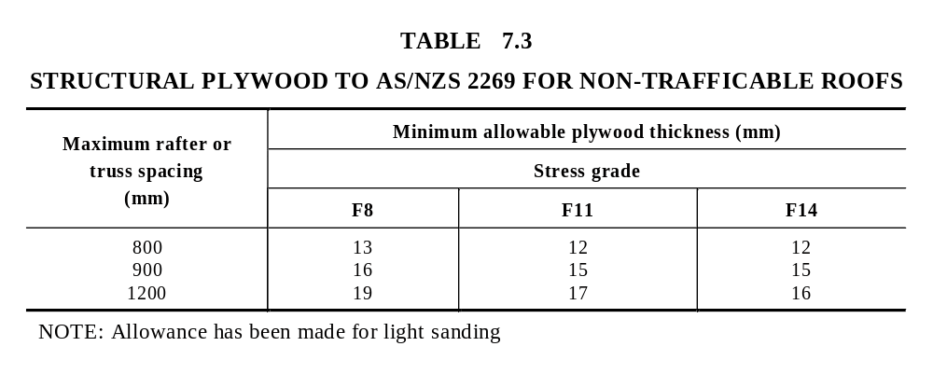

Slide 135
7.3.3.2 Structural plywood non- trafficable roof decking
Plywood sheets shall be laid with the grain of the face ply parallel to the span, and shall be continuous over at least two spans. Tabulated spacing shall be reduced by 25% if supported over one span only.

Slide 136
7.3.3.2 Structural plywood non- trafficable roof decking
Edges of sheets that are not tongued and grooved shall be supported.
Structural plywood shall be fixed to all end and intermediate supports in accordance with Table 7.4.

Slide 137
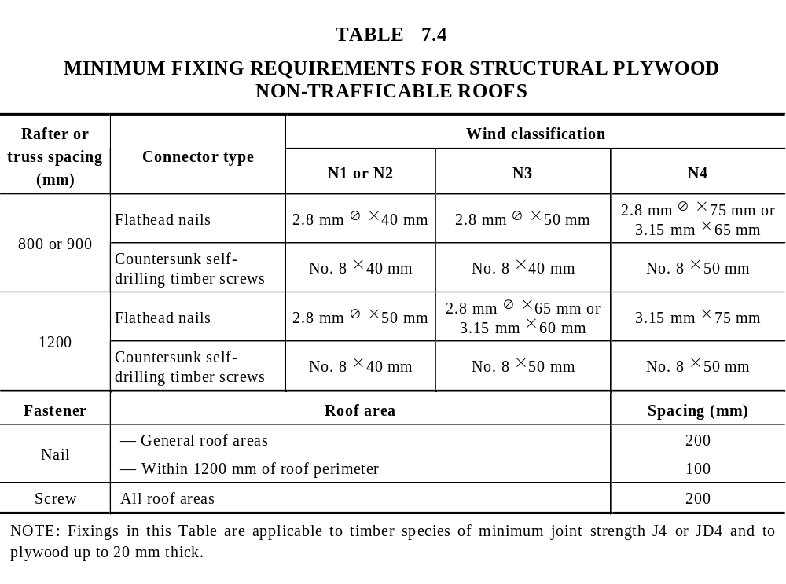

Slide 138
7.3.4 Loads on ceilings
The member sizes given for ceiling joists, hanging beams, and the like, are suitable for the support of normal ceiling loads and linings.
Where ceiling framing is required to support other loads including ladder or stair systems, storage, hot water systems or the like, the framing shall be designed in accordance with AS 1720.1 (see also Clause 7.2.2).

Slide 139
7.3.5 Binders
Binders may be required in ceilings to provide lateral restraint to external walls.
Where required, they shall be a minimum of 35 × 70 mm. See Clause 6.2.5 for details on the lateral restraint of external walls.

Slide 140
7.3.6 Ceiling joists
The size of ceiling joists shall be determined from Span Table 21 (without overbatten) or Span Table 22 (with overbatten) of the Supplements. Overbattens shall be a minimum of 35 x 70 mm F5.
See Figure 7.19 for design parameters for ceiling joists.
A3

Slide 141
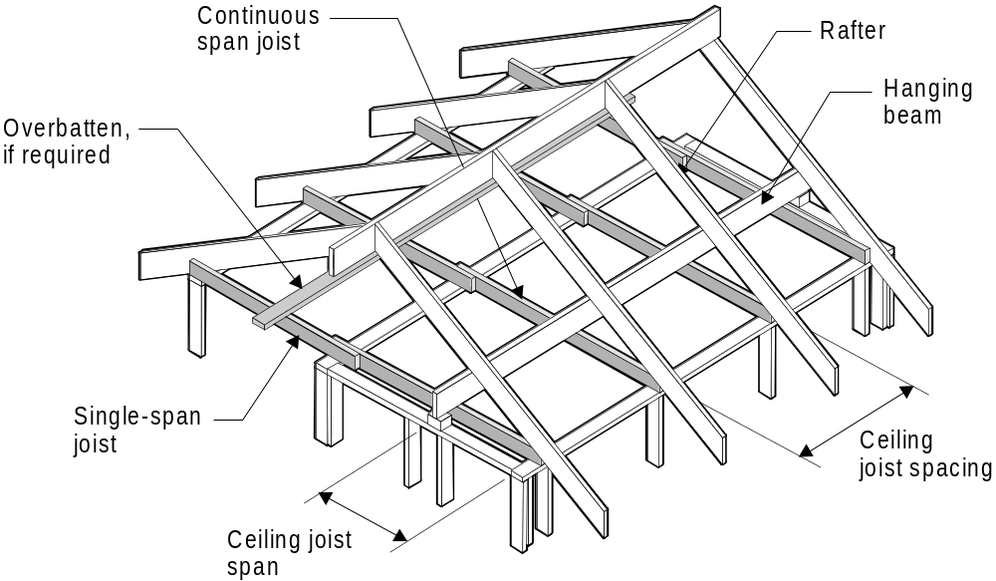
A2
A3
FIGURE 7.19 CEILING JOISTS

Slide 142
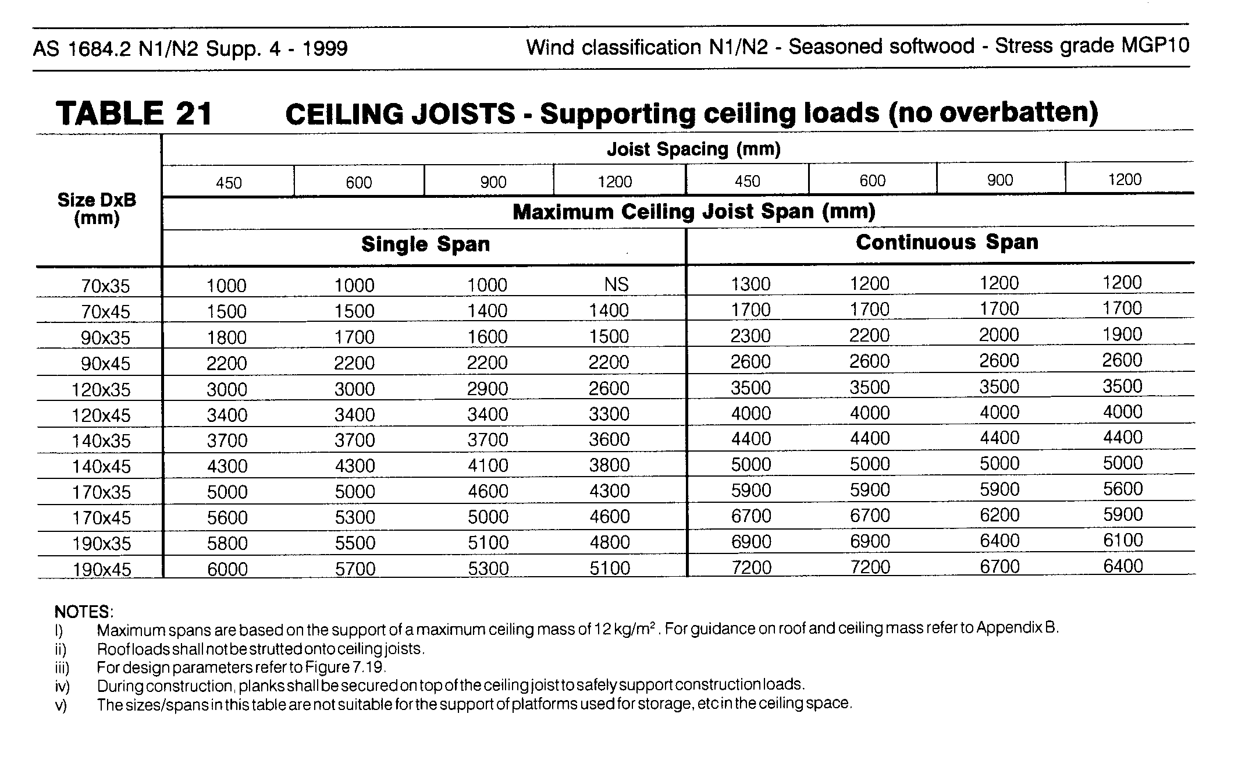

Slide 143
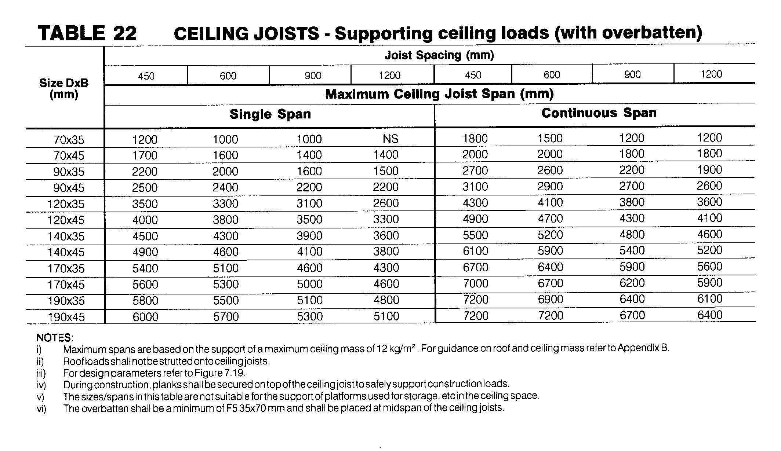

Slide 144
7.3.7 Hanging beams
The size of hanging beams shall be determined from Span Table 23 of the Supplements.
Hanging beams shall support ceiling loads only via ceiling joists.

Slide 145
7.3.7 Hanging beams
The top edge of hanging beams with a depth to breadth ratio exceeding seven shall be laterally restrained at their supports (see Figure 7.18).
See Figure 7.20 for design parameters for hanging beams.

Slide 146
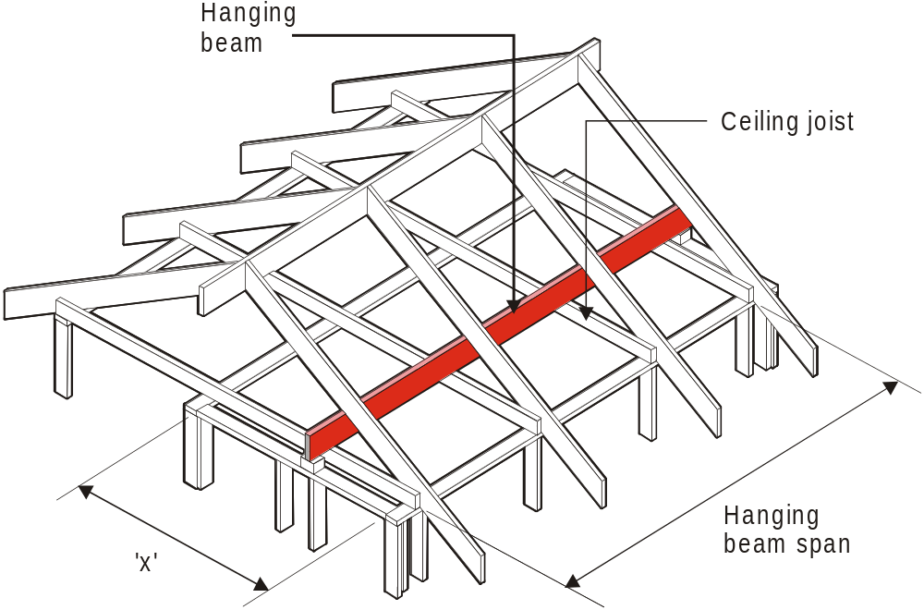
X
2
  Ceiling load width (CLW) =
x = total of ceiling joist spans either side of hanging beam
FIGURE 7.20 HANGING BEAMS

Slide 147
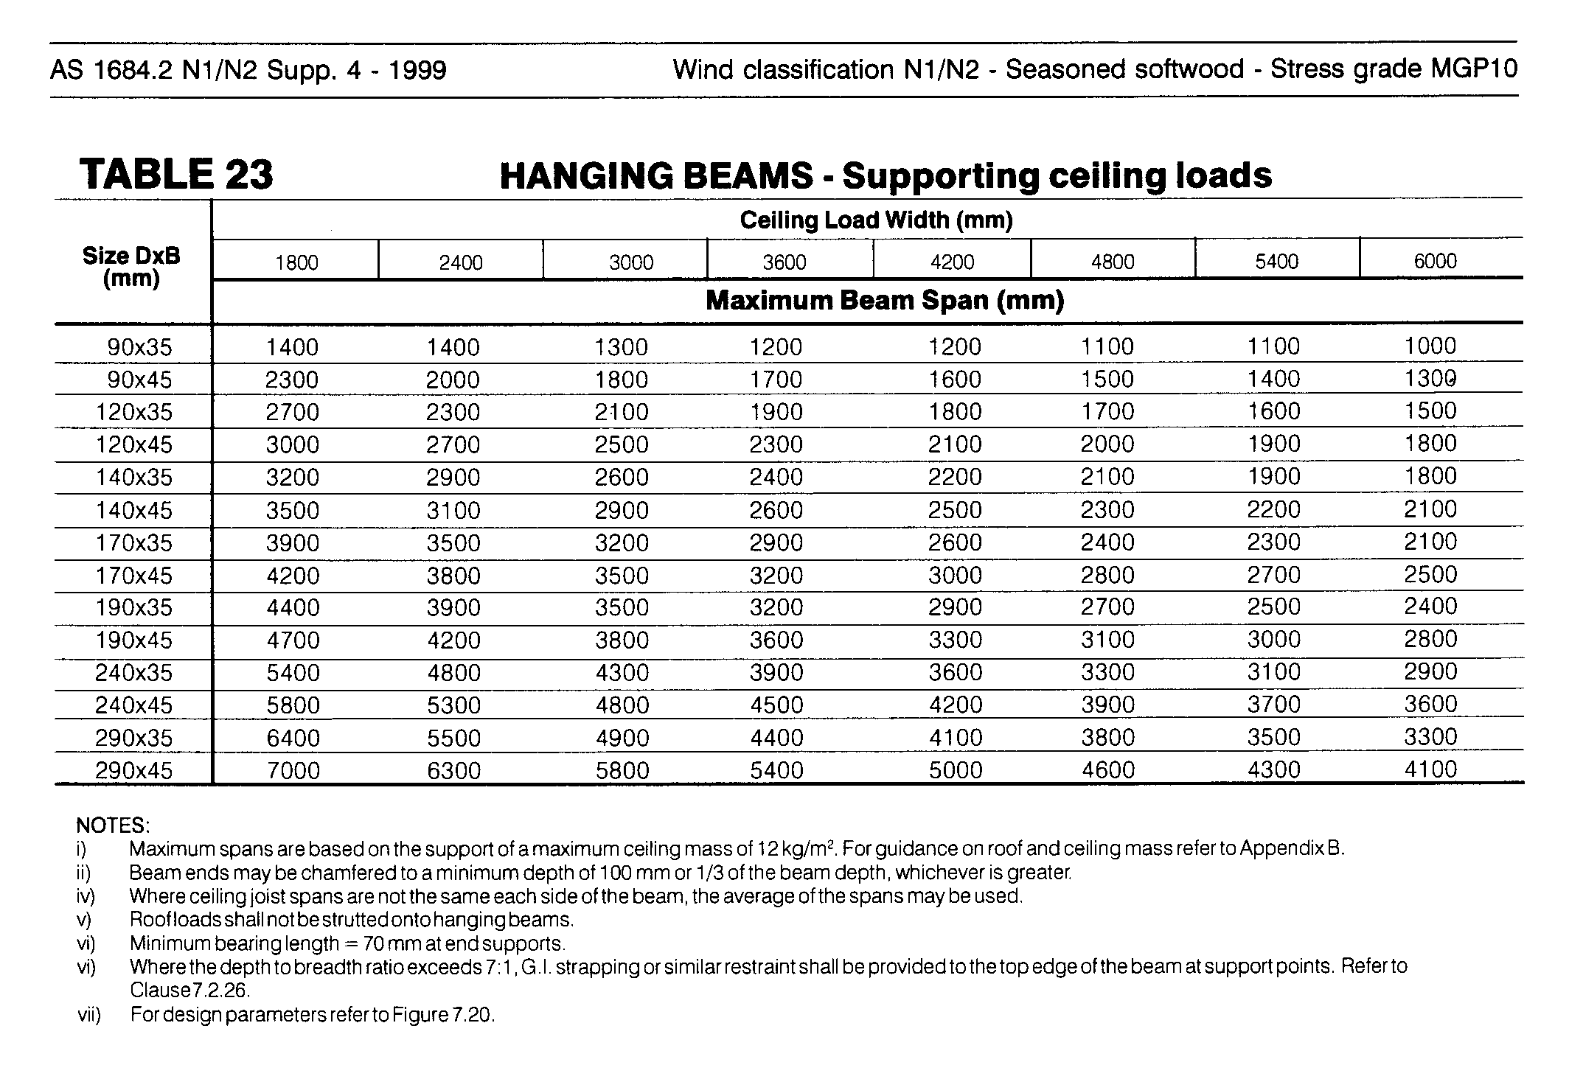

Slide 148
7.3.8 Counter beams
The size of counter beams shall be determined from Span Table 24 of the Supplements. This Span Table may also be used for lintels in internal walls supporting hanging beams.
Counter beams shall support ceiling loads via hanging beams.
See Figure 7.21 for design parameters for counter beams.

Slide 149
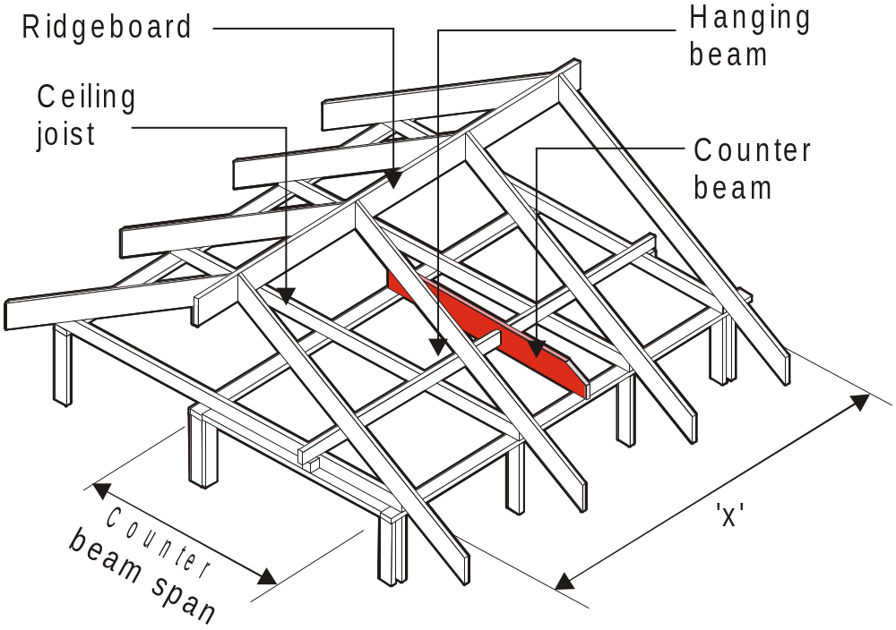
X
2
  Ceiling load width (CLW) =
x = total of hanging beam spans either side of the counter beam
FIGURE 7.21 COUNTER BEAMS

Slide 150
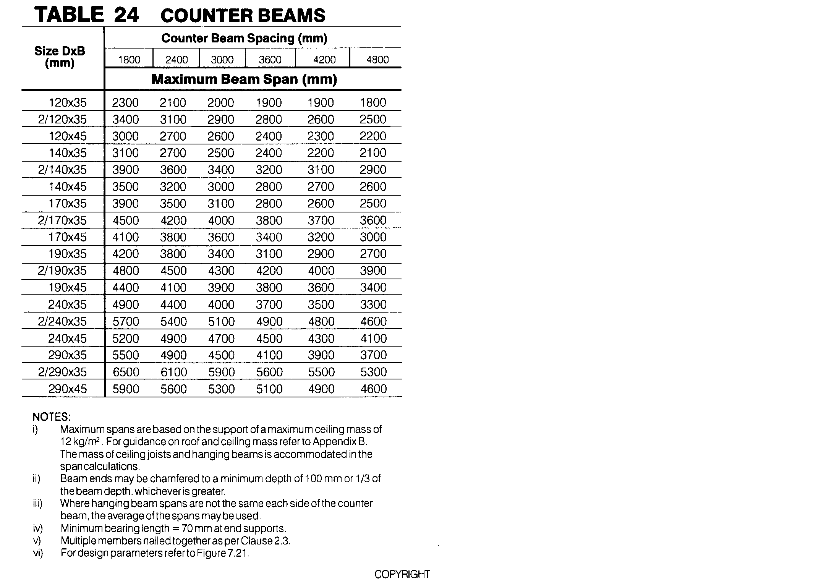

Slide 151
7.3.9 Combined strutting/hanging beams
The size of combined strutting/hanging beams shall be determined from Span Table 25 of the Supplements.
Combined strutting/hanging beams may support both roof loads from struts and ceiling loads from ceiling joists.

Slide 152
7.3.9 Combined strutting/hanging beams
The top edge of combined strutting/hanging beams with a depth to breadth ratio exceeding three shall be laterally restrained at their supports and intermediately at the strutting points (see Figure 7.18).
See Figure 7.22 for design parameters for combined strutting/hanging beams.

Slide 153
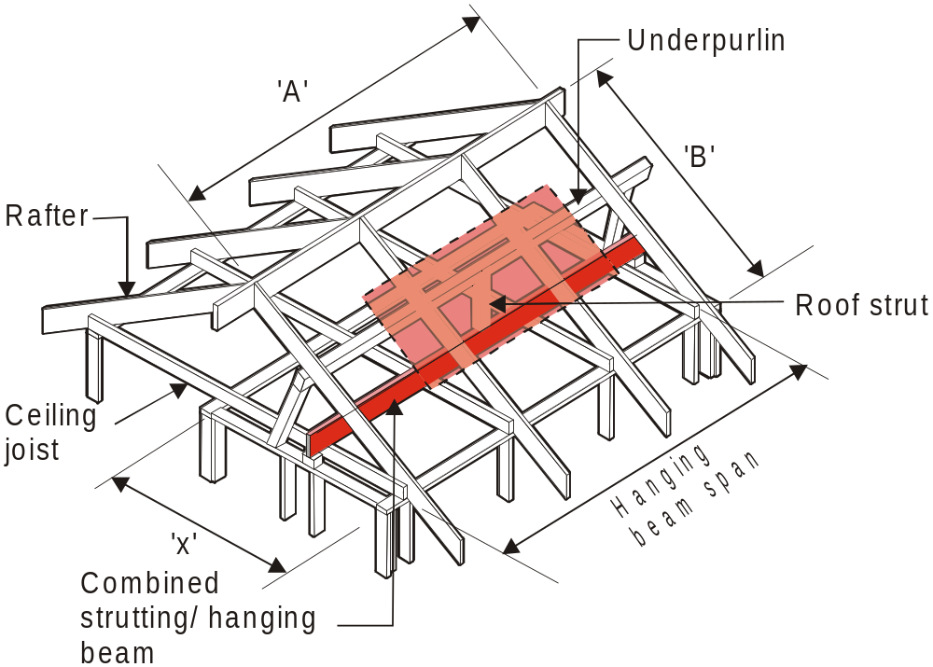
Roof area supported
RIDGE STRUTTED
= (1/2)A x (1/2)B
X
2
  Ceiling load width (CLW) =
  NOTES:
1. Strutting/hanging beams support both roof and ceiling loads.
2. Ridge struts have been omitted for clarity.
FIGURE 7.22 COMBINED STRUTTING/HANGING BEAMS

Slide 154
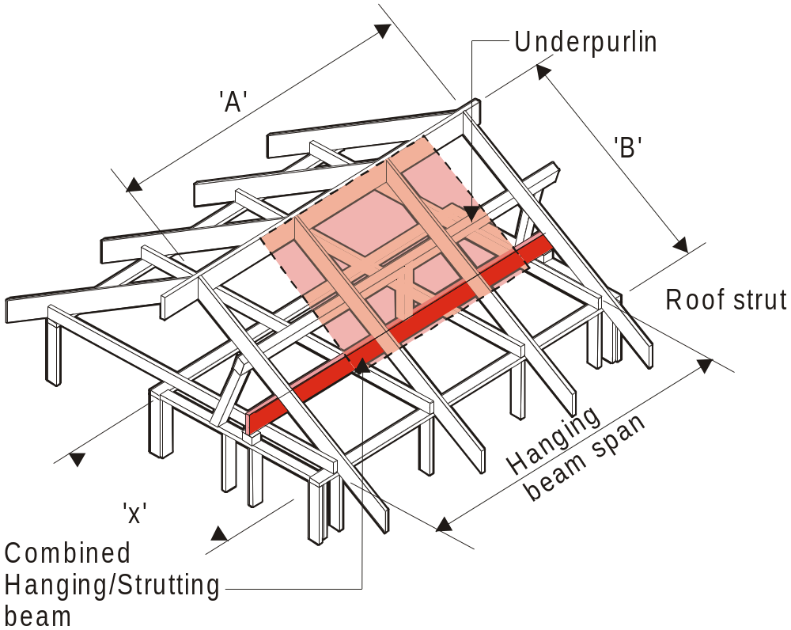
Roof area supported
RIDGE NOT STRUTTED
= (1/2)A x (3/4)B
X
2
  Ceiling load width (CLW) =
FIGURE 7.22 COMBINED STRUTTING/HANGING BEAMS

Slide 155
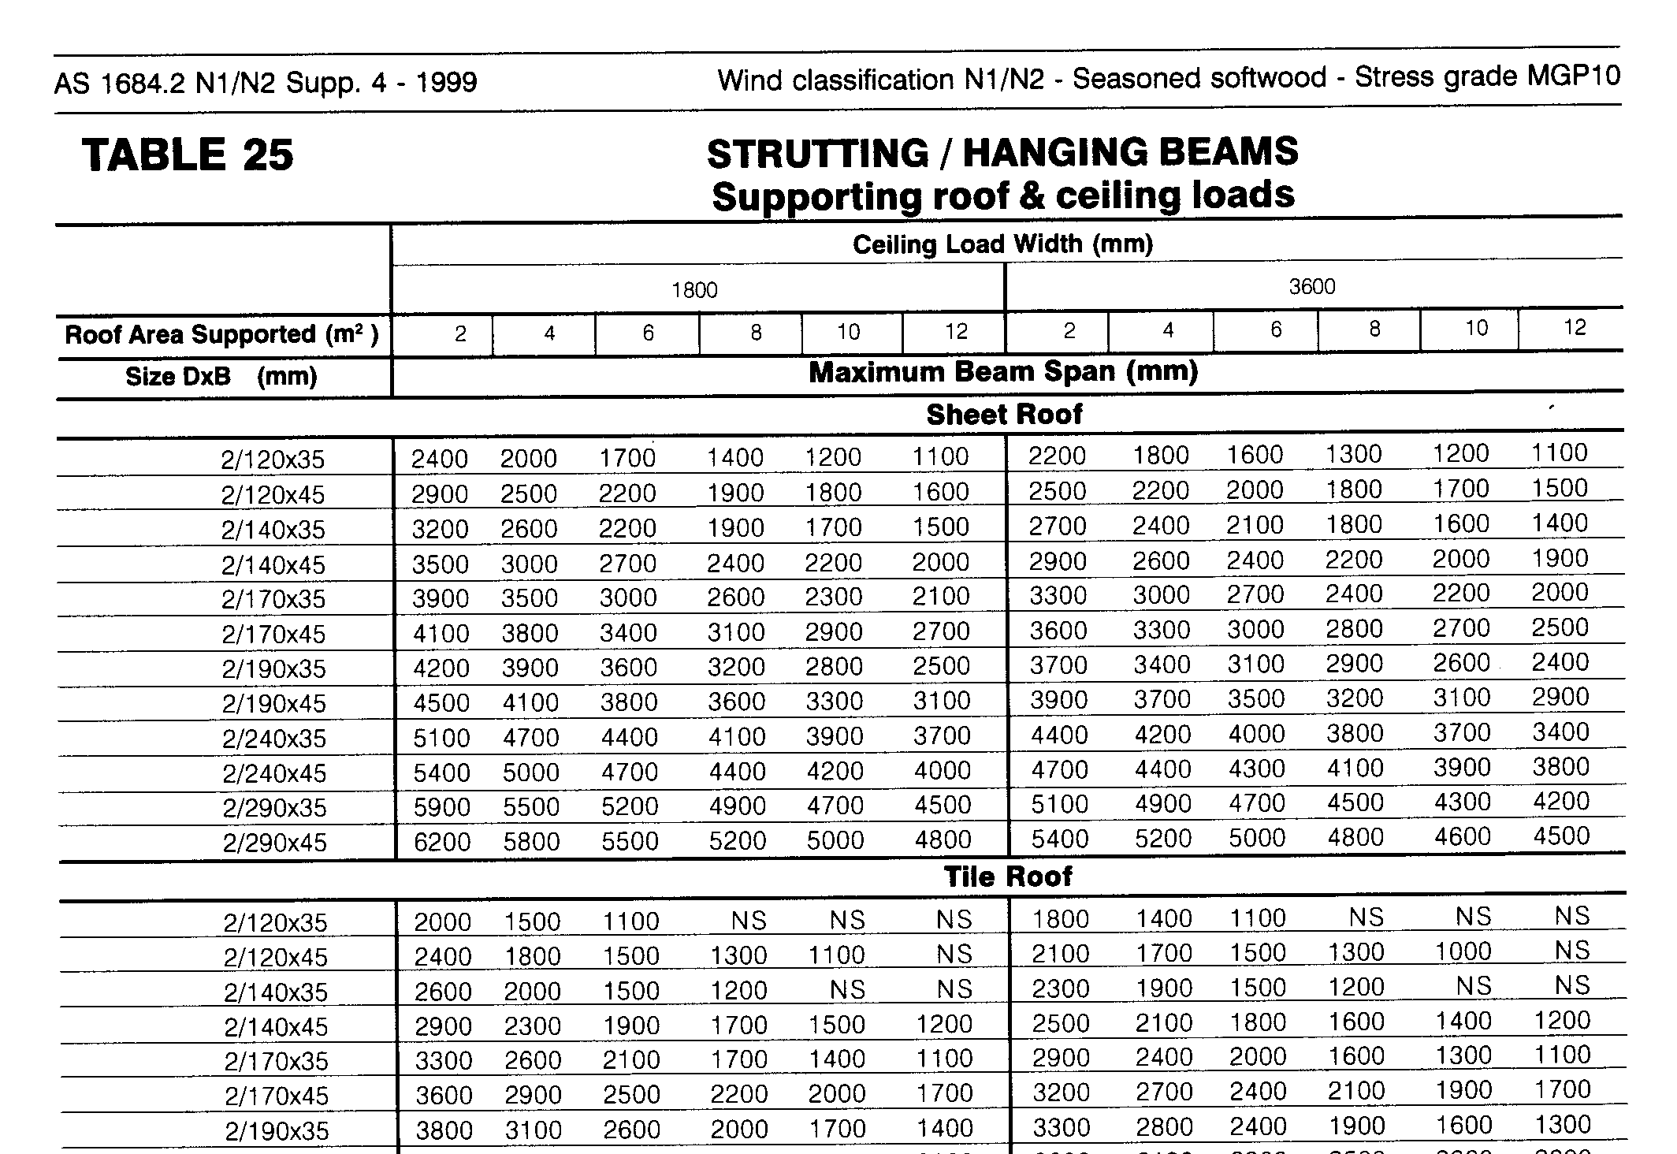

Slide 156
7.3.10 Combined counter-strutting beams
The size of combined counter-strutting beams shall be determined for Span Tables 26 of the Supplements.
Combined counter-strutting beams may support roof loads from struts and hanging beams from ceiling loads.

Slide 157
7.3.10 Combined counter-strutting beams
The top edge of combined counter-strutting beams with a depth to breadth ratio exceeding three shall be laterally restrained at their supports (see Figure 7.18).
See Figure 7.23 for design parameters for combined counter-strutting beams.

Slide 158

Roof area supported
RIDGE STRUTTED
= (1/2)A x (1/2)B
  Ceiling load width
  (CLW) =
X
2
FIGURE 7.23 COMBINED COUNTER-STRUTTING BEAMS

Slide 159

Roof area supported
RIDGE NOT STRUTTED
= (1/2)A x (3/4)B
  Ceiling load width
  (CLW) =
X
2
FIGURE 7.23 COMBINED COUNTER-STRUTTING BEAMS

Slide 160


Slide 161
7.3.11 Strutting beams
The size of strutting beams shall be determined from Span Table 27 of the Supplements. Strutting beams shall support roof loads only.
The top edge of strutting beams with a depth to breadth ratio exceeding three shall be laterally restrained at their supports and intermediately at the strutting points (see Figure 7.18).

Slide 162

Roof area supported
RIDGE STRUTTED
= (1/2)A x (1/2)B
FIGURE 7.24 STRUTTING BEAMS

Slide 163

Roof area supported
RIDGE NOT STRUTTED
= (1/2)A x (3/4)B
FIGURE 7.24 STRUTTING BEAMS

Slide 164


Slide 165
7.3.12 Underpurlins
The size of underpurlins shall be determined from Span Table 28 of the Supplements.
The ends of underpurlins may project (cantilever) beyond a support by up to 25% of the maximum allowable span of the underpurlin, provided the actual backspan is at least three times the cantilever length.
See Figure 7.25 for design parameters for underpurlins.

Slide 166


RWL - RIDGE
STRUTTED
FIGURE 7.25 UNDERPURLINS

Slide 167

RWL - RIDGE
NOT STRUTTED
FIGURE 7.25 UNDERPURLINS

Slide 168


Slide 169
7.3.13 Rafters and purlins
7.3.13.1 General
The size of rafters or purlins shall be determined from Span Table 29 of the Supplements.
For rafters supporting roof loads only, see Figure 7.26 for design parameters.
Where rafters support both roof and ceiling loads, see Figure 7.27.

Slide 170

(a) Single span (b) Continuous span
NOTES:
1. Maximum birdsmouth = 1/3 of rafter depth.
2. For overhang and span limits, see Span Tables
FIGURE 7.26 RAFTERS/PURLINS (COUPLED ROOFS)

Slide 171

(a) Single span (b) Continuous span
NOTES:
1. Maximum birdsmouth = 1/3 of rafter depth.
2. For overhang and span limits, see Span Tables
and Clauses 7.3.13.2 and 7.3.13.3.
FIGURE 7.27 RAFTERS SUPPORTING ROOF AND CEILING LOADS
(NON-COUPLED OR CATHEDRAL ROOFS

Slide 172


Slide 173
7.3.13.2 Rafter overhangs
Rafter overhang limits contained in the Span Tables are applicable for use with a birdsmouth notch not exceeding one third of the rafter depth in combination with a structural fascia that is rigidly connected to the ends of the rafters (see Figure 7.28(a)).
A minimum timber (softwood) structural fascia of 190 × 19 mm shall be used.
A2

Slide 174
7.3.13.2 Rafter overhangs
Where non-structural fascias are used, the allowable overhangs shall be two-thirds of that permitted by the Span Tables.
A4

Slide 175
7.3.13.2 Rafter overhangs
NOTE: The maximum overhangs permitted by the Span Tables and Clause7.3.13.3 may not be suitable for the support of attachments (pergolas and the like) to the ends of overhangs.

Slide 176
7.3.13.3 Birdsmouthed and non- birdsmouthed rafters
Where rafters are not birdsmouthed over top plates as shown in Figure 7.28(b), the allowable overhang may be 30% of the single span value, for all roof masses. Rafters shall be supported by means of wedges or other alternative support systems, such as framing anchors that provide equivalent bearing support.
A4

Slide 177
7.3.13.3 Birdsmouthed and non- birdsmouthed rafters
Where rafters are birdsmouthed less than one third of the depth of the rafter, the allowable overhang may be determined by interpolation between the overhang permitted for a one-third-depth birdsmouth and the overhang permitted for a non-birdsmouthed rafter.

Slide 178
FIGURE 7.28 RAFTER OVERHANG AND BIRDSMOUTHING

Slide 179
7.3.13.4 Dressed rafters
Table 7.5 provides span and overhang reductions for dressed (undersize) rafters, as may be used in cathedral or flat/skillion roofs where rafters are exposed to view.

Slide 180
7.3.13.4 Dressed rafters
Unseasoned timber dressed sizes shall not be more than 10 mm in depth or thickness under the nominal sizes stated in the rafter Span Tables except that for 38 mm nominal thickness, the dressed thickness shall be not less than 32 mm.
Seasoned timber dressed sizes shall not be more than 10 mm in depth and 5 mm in thickness under the sizes stated in the rafter Span Tables.

Slide 181
7.3.13.4 Dressed rafters
Where the nominated sections suitable for nail lamination are used, each lamination shall not be more than 10 mm in depth and 5 mm in thickness under the sizes stated.
The allowable overhang shall not exceed 30% of the reduced span value for a dressed rafter.

Slide 182


Slide 183
7.3.14 Ridge or intermediate beams — Cathedral, skillion roofs, or the like
The size of ridge or intermediate beams in non-coupled cathedral or skillion roofs shall be determined from Span Tables 30 and 31 of the Supplements for single and continuous spans respectively.
See Figure 7.29 for design parameters for ridge and intermediate beams.

Slide 184

X
2
Y
2
X
2
Roof load width (RLW) = +
Roof load width (RLW) =
(a) Ridge beams (b) Intermediate beams
FIGURE 7.29 RIDGE AND INTERMEDIATE BEAMS

Slide 185


Slide 186


Slide 187
7.3.15 Roof battens
The size of roof battens shall be determined from Span Table 32 of the Supplements.
The Span Table provides sizes for roof battens supporting roofing loads only for spans up to 1200 mm.

Slide 188
7.3.15 Roof battens
For spans greater than 1200 mm or where roofing and ceiling loads are supported, the size may be determined from Span Table 29 of the Supplements for rafters and purlins where those members are to be used only on their edge.
See Figure 7.30 for design parameters for roof battens.

Slide 189

FIGURE 7.30 ROOF BATTENS

Slide 190


Slide 191
7.3.16 Cantilevered gable ends
Where cantilevered at gable ends as shown in Figure 7.31, the size of lintels, verandah beams, underpurlins, and the like, shall be determined from the appropriate Span Table for a single span equal to three times the cantilever distance. The backspan of the cantilevered member shall be at least twice the cantilever length. For ridge and intermediate beams, the cantilever shall not exceed the value given in Span Tables.

Slide 192

FIGURE 7.31 CANTILEVERED GABLE ENDS

Slide 193
7.3.17 Other members or components
Table 7.6 gives details of requirements for miscellaneous roof framing members not given in the Span Tables of the Supplements.

Slide 194
7.3.17 Other members or components
Junction of ridgeboard and hip or valley rafters shall be strutted where hip or valley rafters exceed 5 m span, or where underpurlins are supported off hip rafters.
Roof strut length shall be measured from the underside of the underpurlin/ridgeboard/hip rafter to the top of the strutting beam/wall.

Slide 195

TABLE 7.6
OTHER MEMBERS AND COMPONENTS
A3

Slide 196

TABLE 7.6
OTHER MEMBERS AND COMPONENTS continued

Slide 197

TABLE 7.6
OTHER MEMBERS AND COMPONENTS continued

